Slide 1
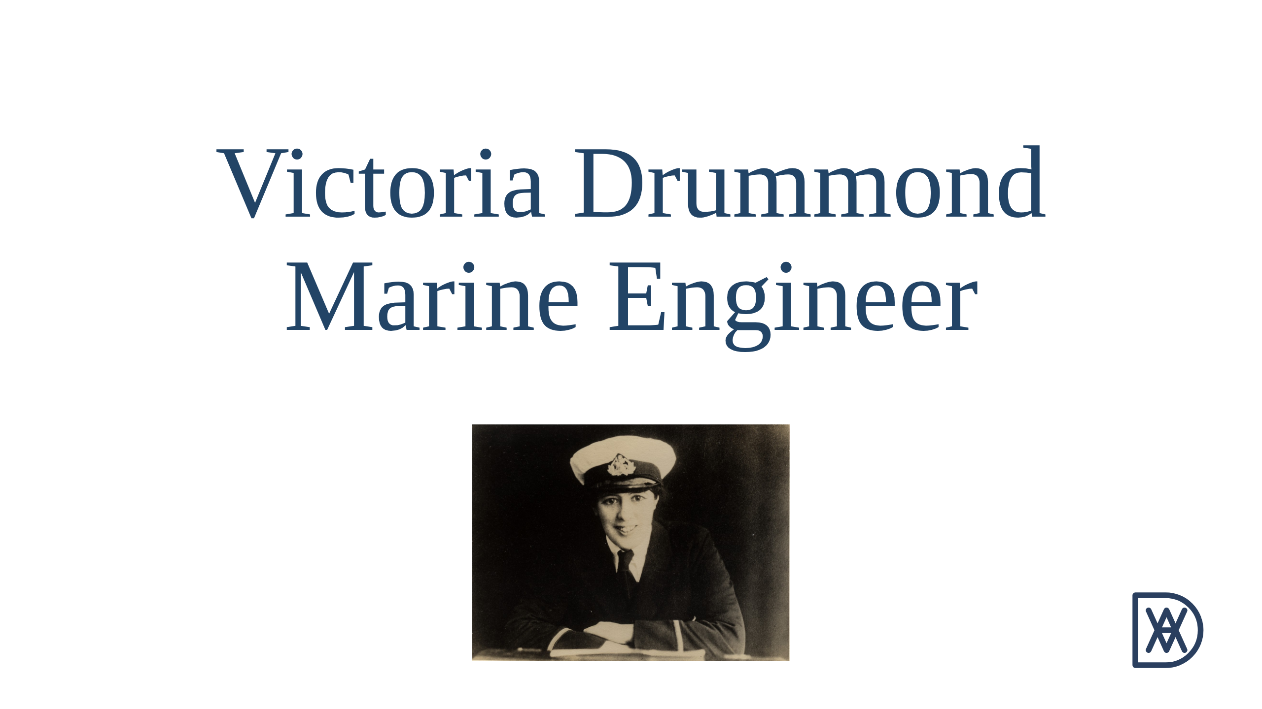

Slide 2
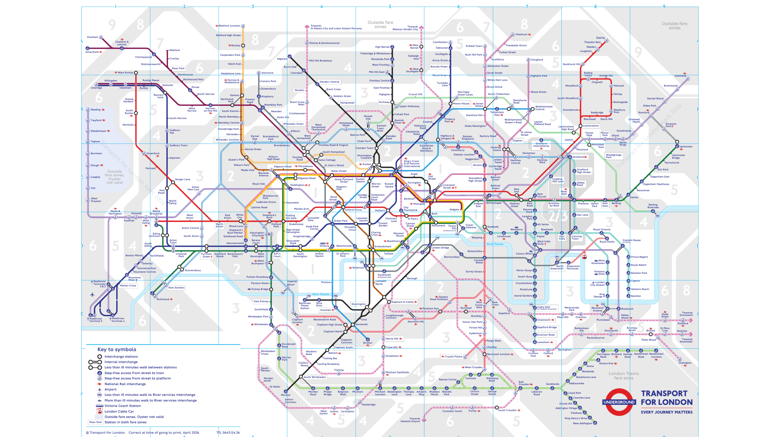
Notes:
Opening slide. Walk on in the tube map apron and let the audience make
the connection between the apron and the screen before saying anything.
This is the ordinary TfL Tube map (April 2026). Ask them to hold the
picture in their heads: we are going to change every name on it.
Script section 0.

Slide 3
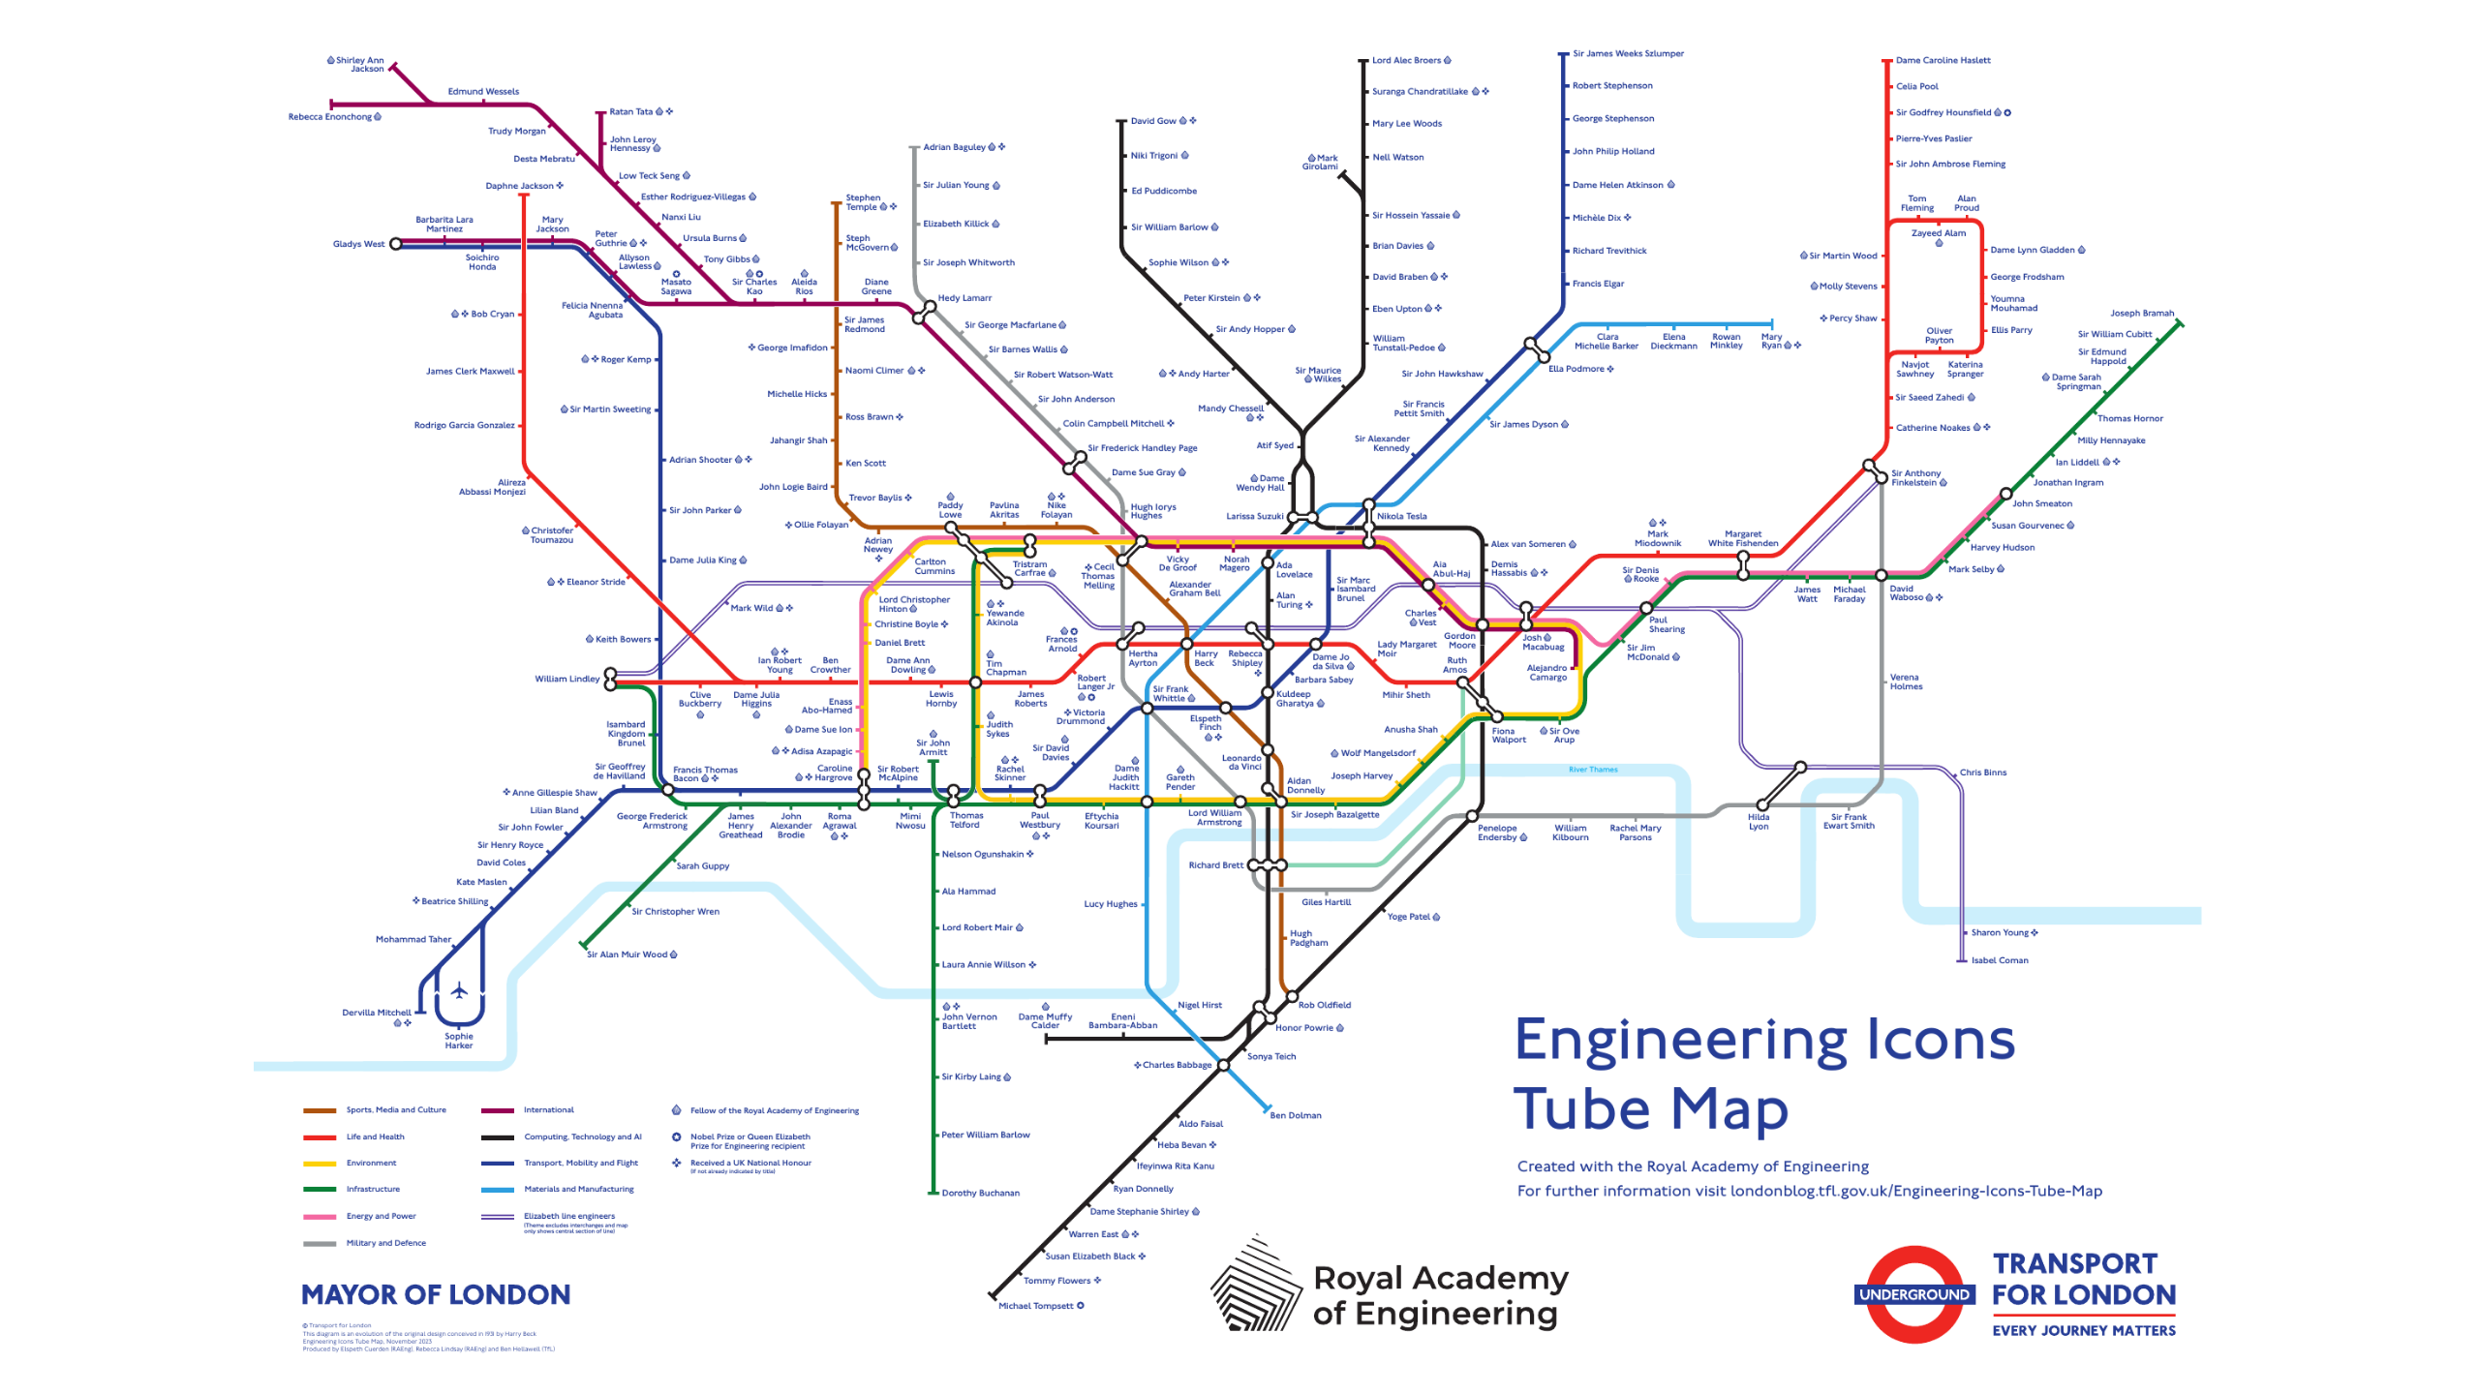
Notes:
Same map, every station renamed. The Engineering Icons Tube Map, made by
Transport for London with the Royal Academy of Engineering for National
Engineering Day, 1 November 2023. 274 stations, 274 engineers, one theme
per line: the Central line is Life and Health, the Northern line
Computing and AI, the Piccadilly line Transport, Mobility and Flight.
Harry Beck, who drew the original diagram, is Oxford Circus; Brunel is
Ealing Common; Ada Lovelace is Warren Street. Somewhere on this map is a
marine engineer. Where?
Isamabard Kingdom Brunel
Christopher Wren
Robert Stephenson
Sir James Dyson
Victoria Drummond

Slide 4
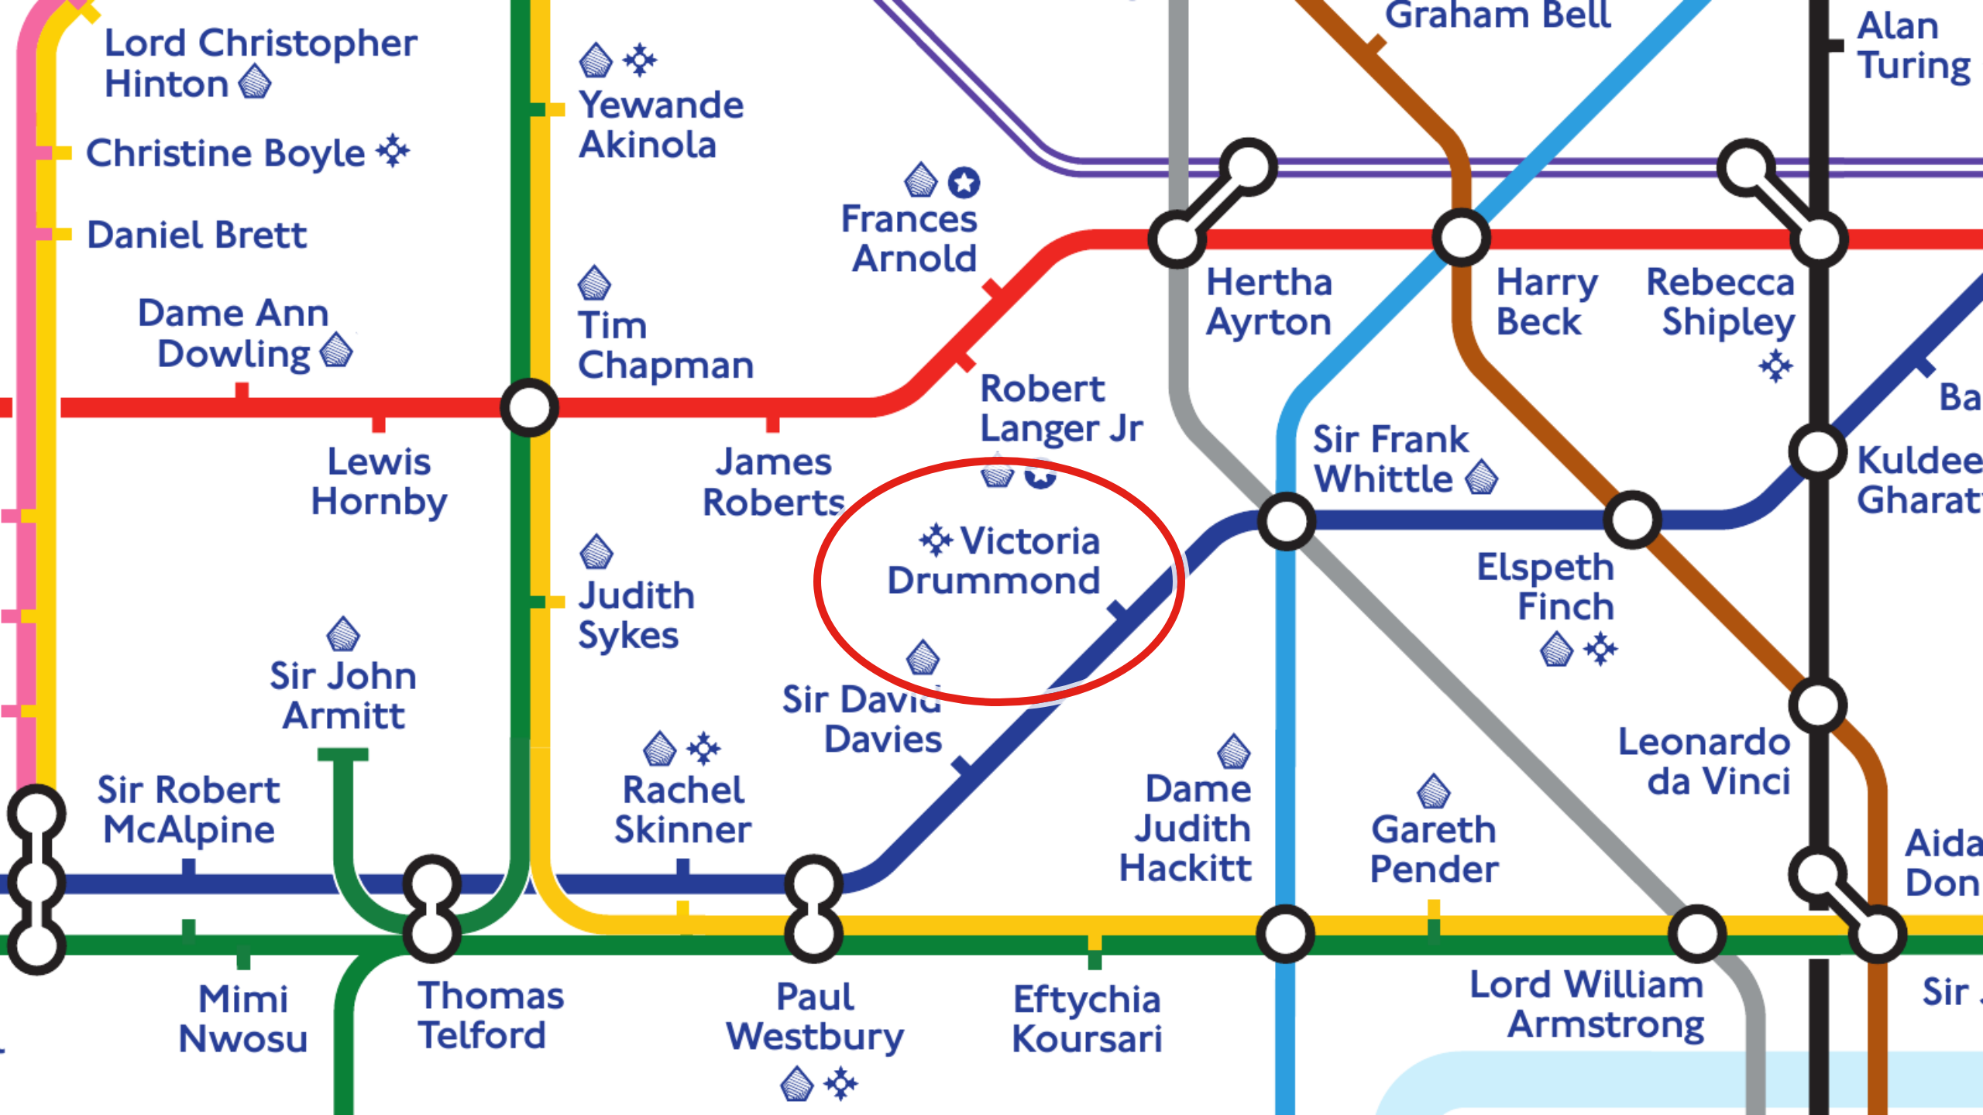
Notes:
Zoom in. A red ring closes in on her name a second after the slide comes
up, then pulses. Piccadilly line, dark blue, the Transport, Mobility and Flight
theme. Green Park has become Sir Frank Whittle, inventor of the jet
engine. One stop on towards Knightsbridge, where Hyde Park Corner should
be: Victoria Drummond. The small four-pointed star beside her name means
she received a UK national honour, her MBE of 1941. So who was she, and
how did a woman born in 1894 end up on this map next to Frank Whittle?
That is the next thirty minutes.

Slide 5
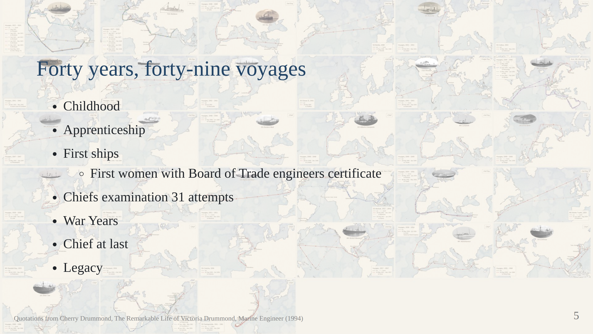
Notes:
The whole arc on one slide, so the audience knows where we are going.
Do not read it out; point at 31 times and say "hold on to that number".
My daughter would like the credit for the idea of the background.
This is an overview of where we we are going.
Childhood
- Apprenticeship
- First ships
- Chiefs examination 31 attempts
- War Years
- Chief at last
- Legacy

Slide 6
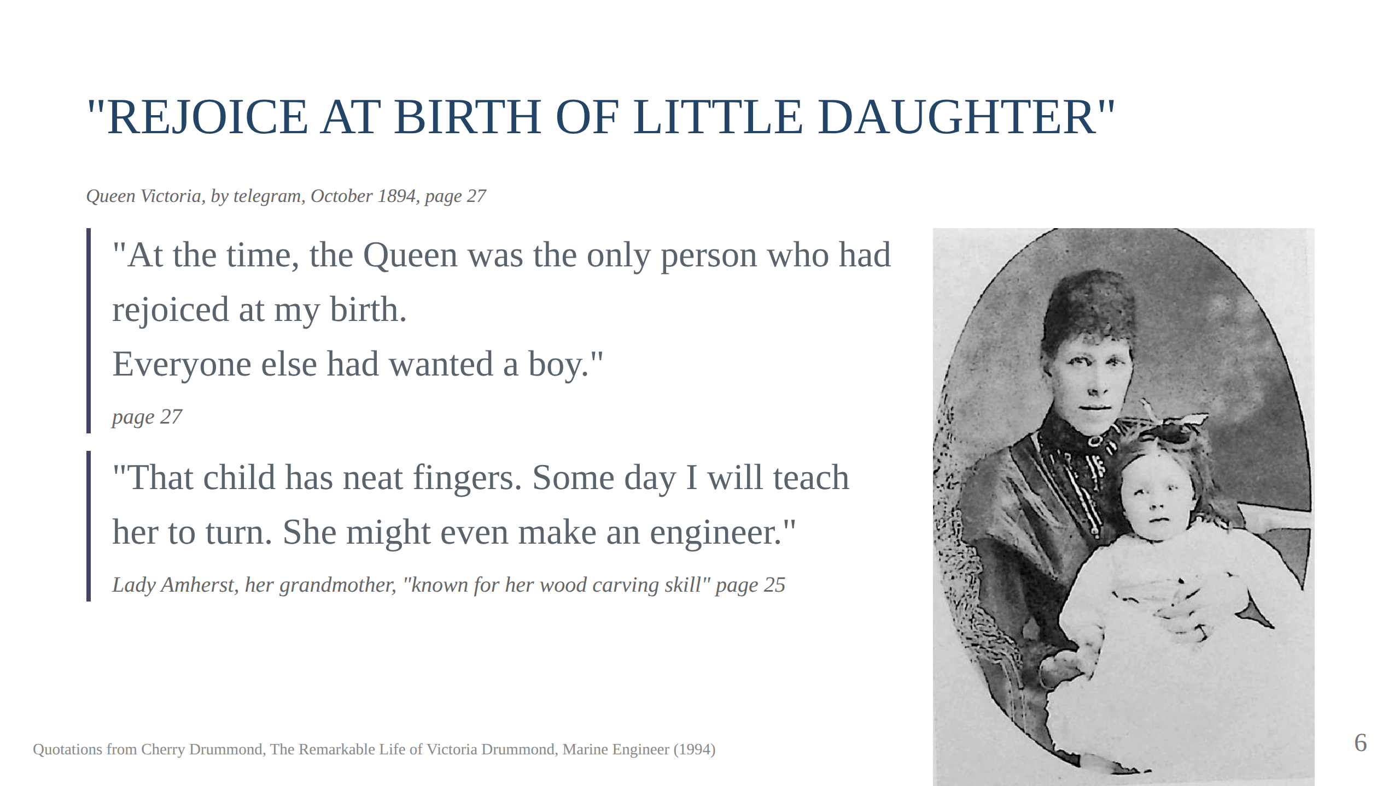
Notes:
Why Victoria Alexandrina
Her father Captain Malcolm Drummond, Groom in Wwaiting to Queen Victoria. She was one of Queen Victoria's godchildren. They were
mostly named Victoria Alexandrina after the queen who was Alexandrina Victoria or Victor Albert after her beloved husband.
Her grandmother who was a noted wood carver and decorated much of the family home notice her neat fingers.

Slide 7
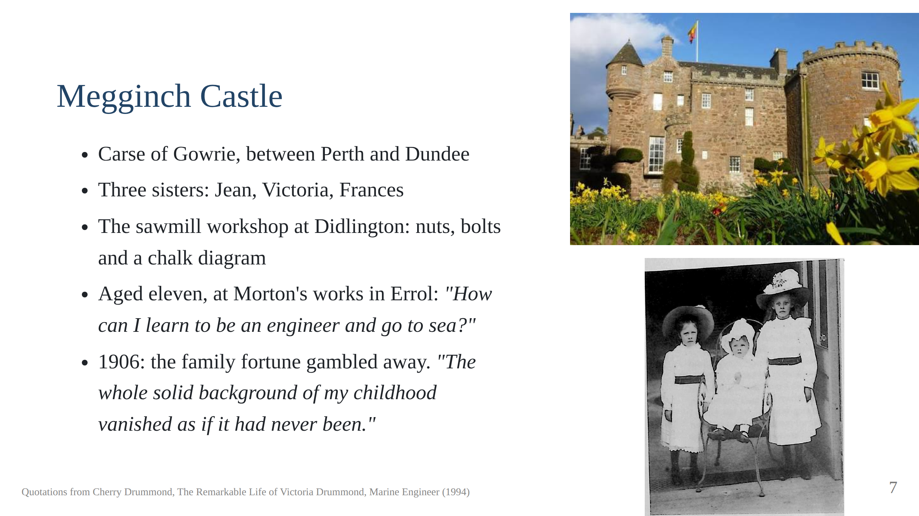
Notes:
Megginch Castle, the family home, above; the three sisters
Aged 11 at the local engineering works/garage in neibouring Village of Errols She is reputed to has asked How can I learn to be an engineer and go to sea.
AT 12 she won a competition for a model boat Presented at Court 1913,
1914 the start of world war 1, "the end of a golden age".

Slide 8
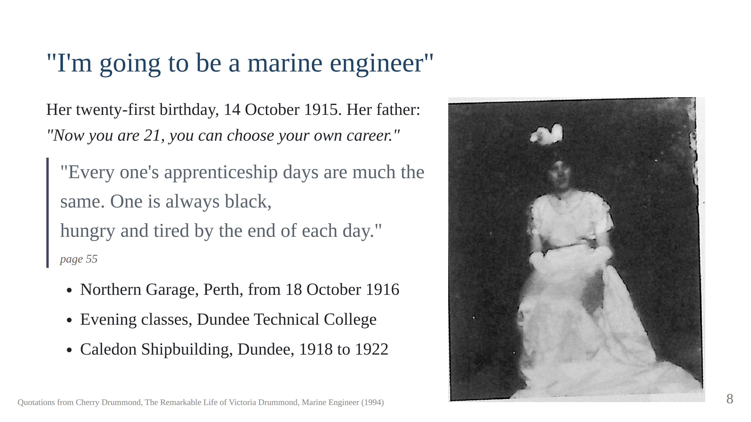
Notes:
Whe worked in a garge in Perth, a local garage. She was laid up after a 10tonne lorry fell on her but suffered nothing worse
that a broken collar bone and a couple of broken ribs. Mr Malcolm the alcholic engineer was her teacher for a couple of years
until he got fired and she left.
Mr Malcolm's advice: keep all your fingers, a hand for yourself and a hand
for your master.
She then left to be an apprentice in the local Caledon shipyard. With the war, the suffragette movement this was an avenue now open
to her.
The two-inch steel cube filed to within two thousandths. Script section 3.

Slide 9
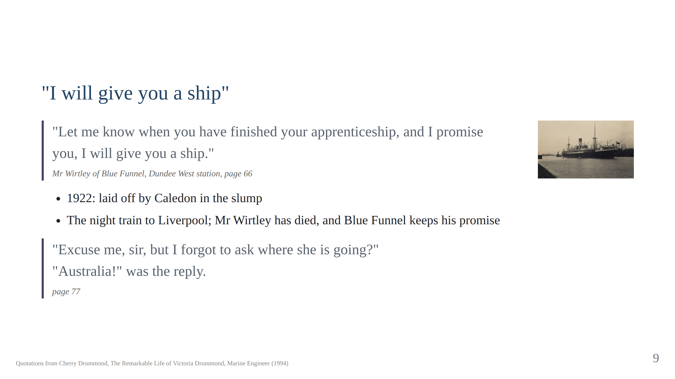
Notes:
And there was a promise. On the platform at Dundee West station her father
had introduced her to Mr Wirtley, a director of the Blue Funnel Line. "Let
me know when you have finished your apprenticeship, and I promise you, I
will give you a ship." Mr Wirtley died before she finished. In 1922, in the
slump, the Caledon yard laid her off. She went to Liverpool, and Blue
Funnel honoured a dead man's promise.
Blue Funnel's steamers were coal burners. The Anchises had twenty-four
fires. She signed on as Tenth Engineer at ten pounds a month. "I don't
think I shall ever forget," she wrote, "the feeling of excited elation on
signing my first articles." (page 75) It was only afterwards that she went
back to the office: "Excuse me, sir, but I forgot to ask where she is
going?" "Australia!" was the reply. (page 77)

Slide 10
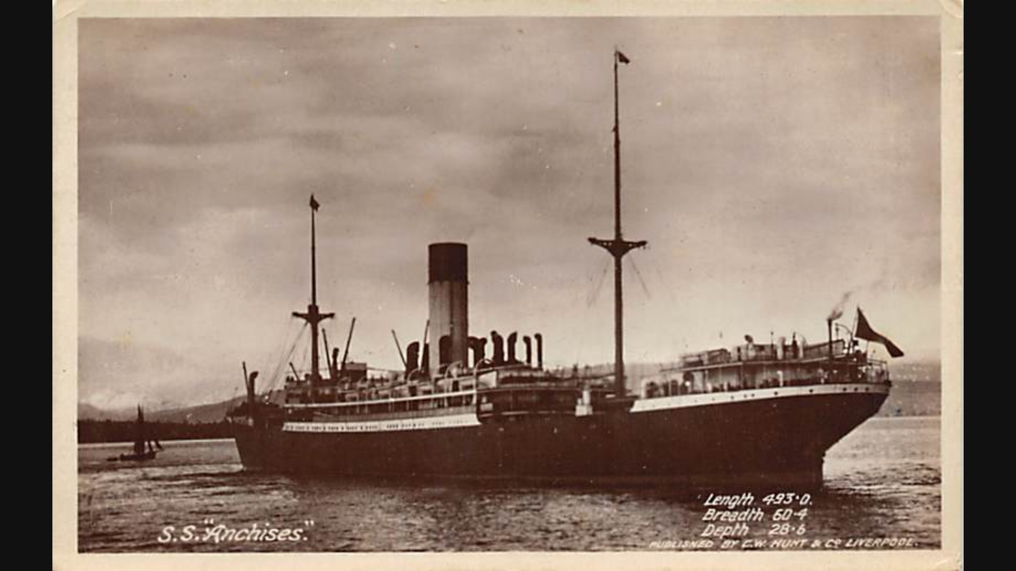

Slide 11
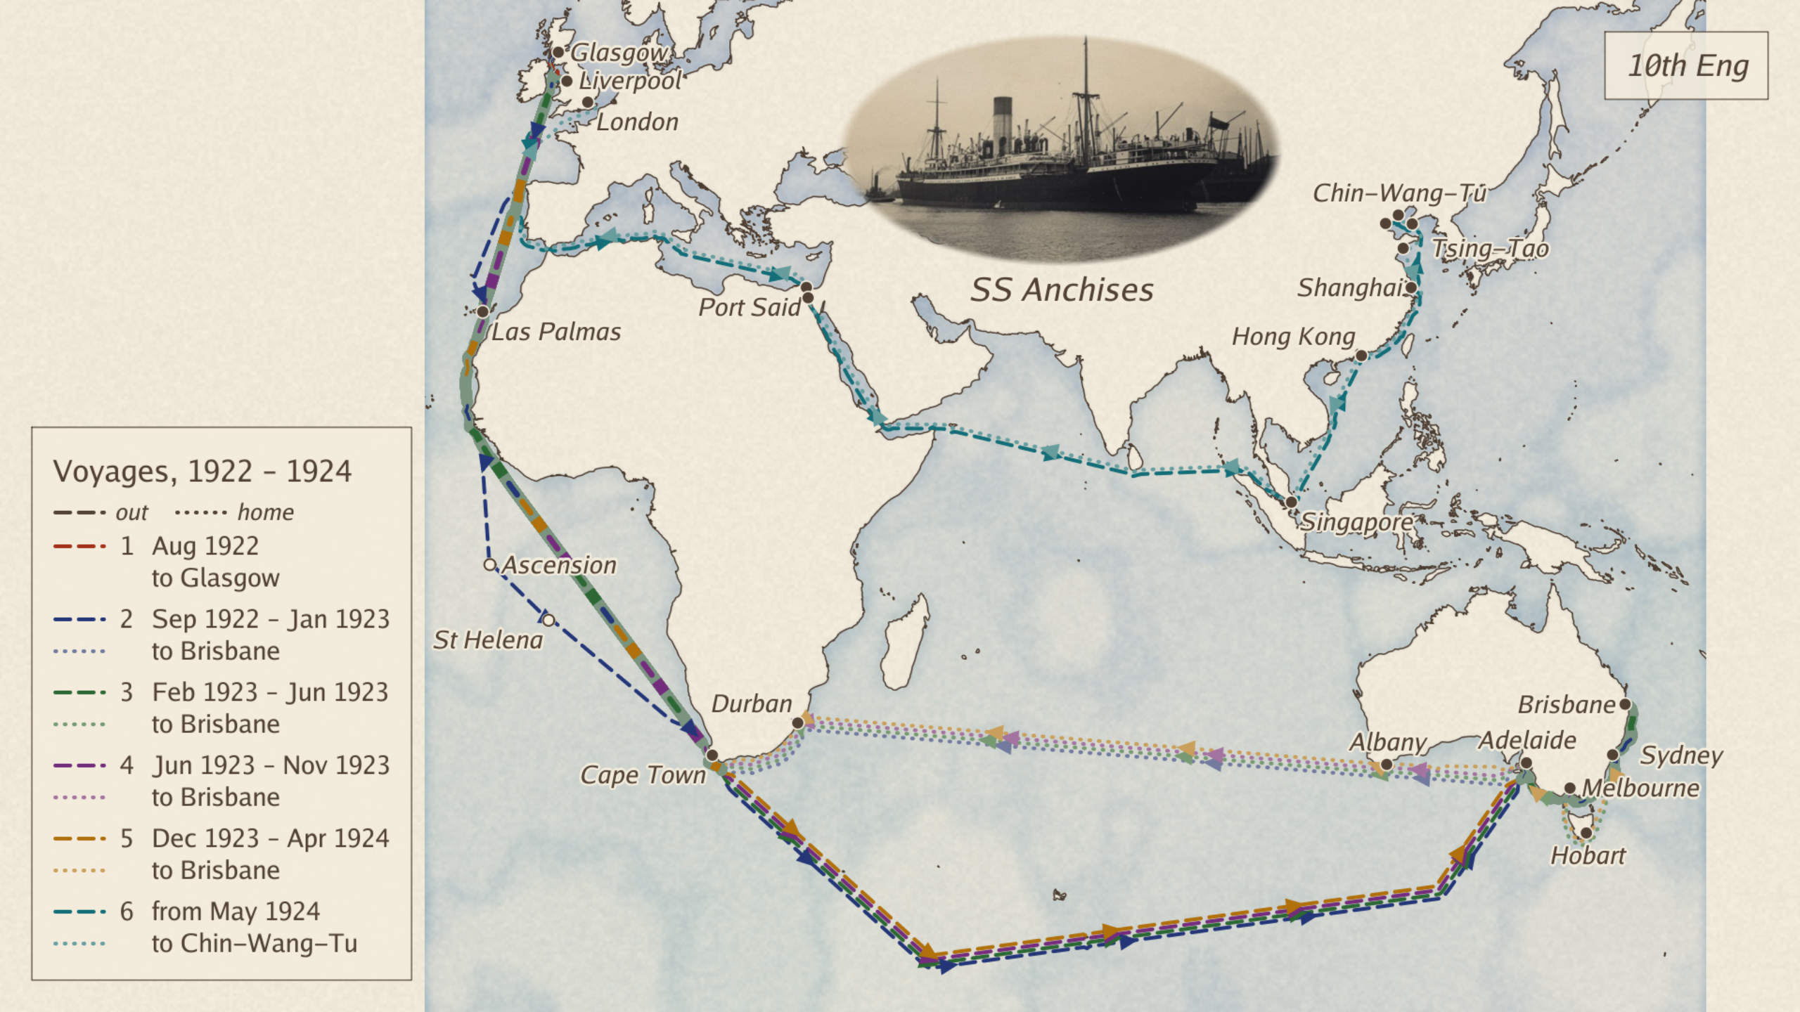
Notes:
They sailed from Glasgow on the second of September 1922, by way of Cape
Town to Adelaide, Melbourne, Sydney and Brisbane. She kept the four-to-eight
watch, scaled evaporators, overhauled pumps, and measured the coal in the
bunkers with the Chief. A fortnight out she slipped at the top of the
fifty-foot ladder in the after well, and a greaser caught her by the
shoulder. The Chief banned her from the well.
The passengers were a separate world. One lady said to her, "You must find
it hot working in that, but I suppose you wear white linen in the engine
room!" (page 82) In Brisbane she was the guest of the Governor. The
Australian Institute of Engineers gave her a gold brooch in the shape of a
rudder. She came home to Birkenhead in January 1923 and wrote: "I felt
quite proud of myself, having made a voyage half round the world as Tenth
Engineer. No one ever thought I would stick it out, but I did." (page 92)

Slide 12
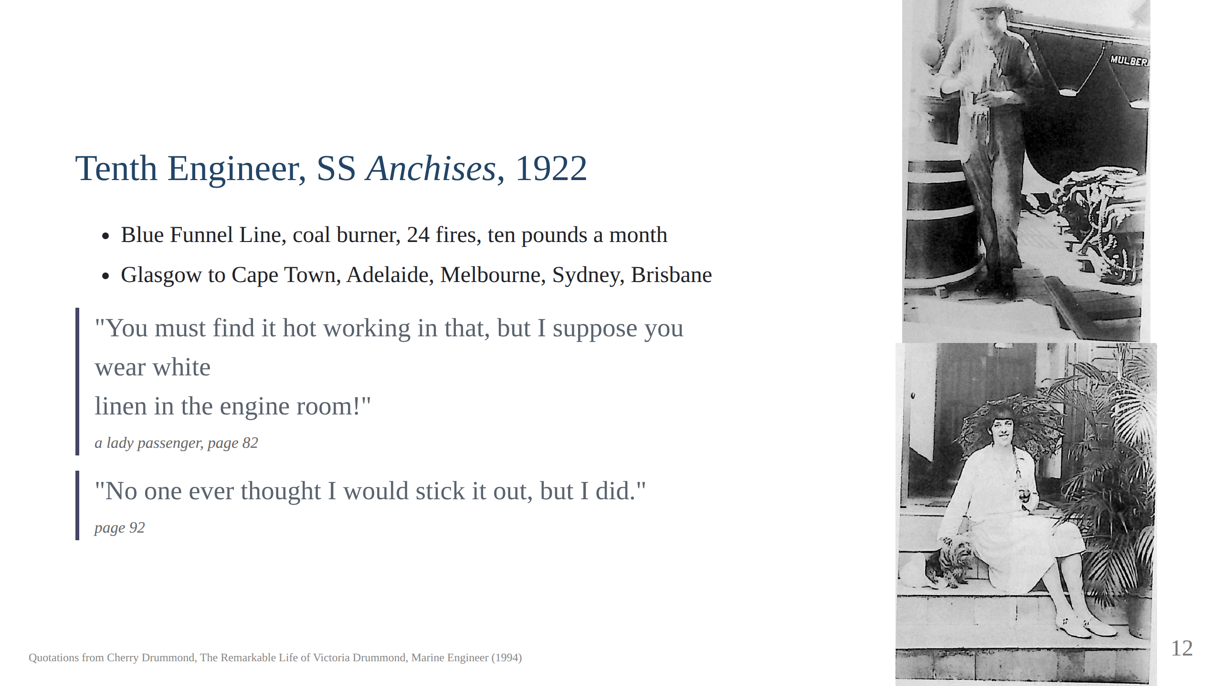

Slide 13
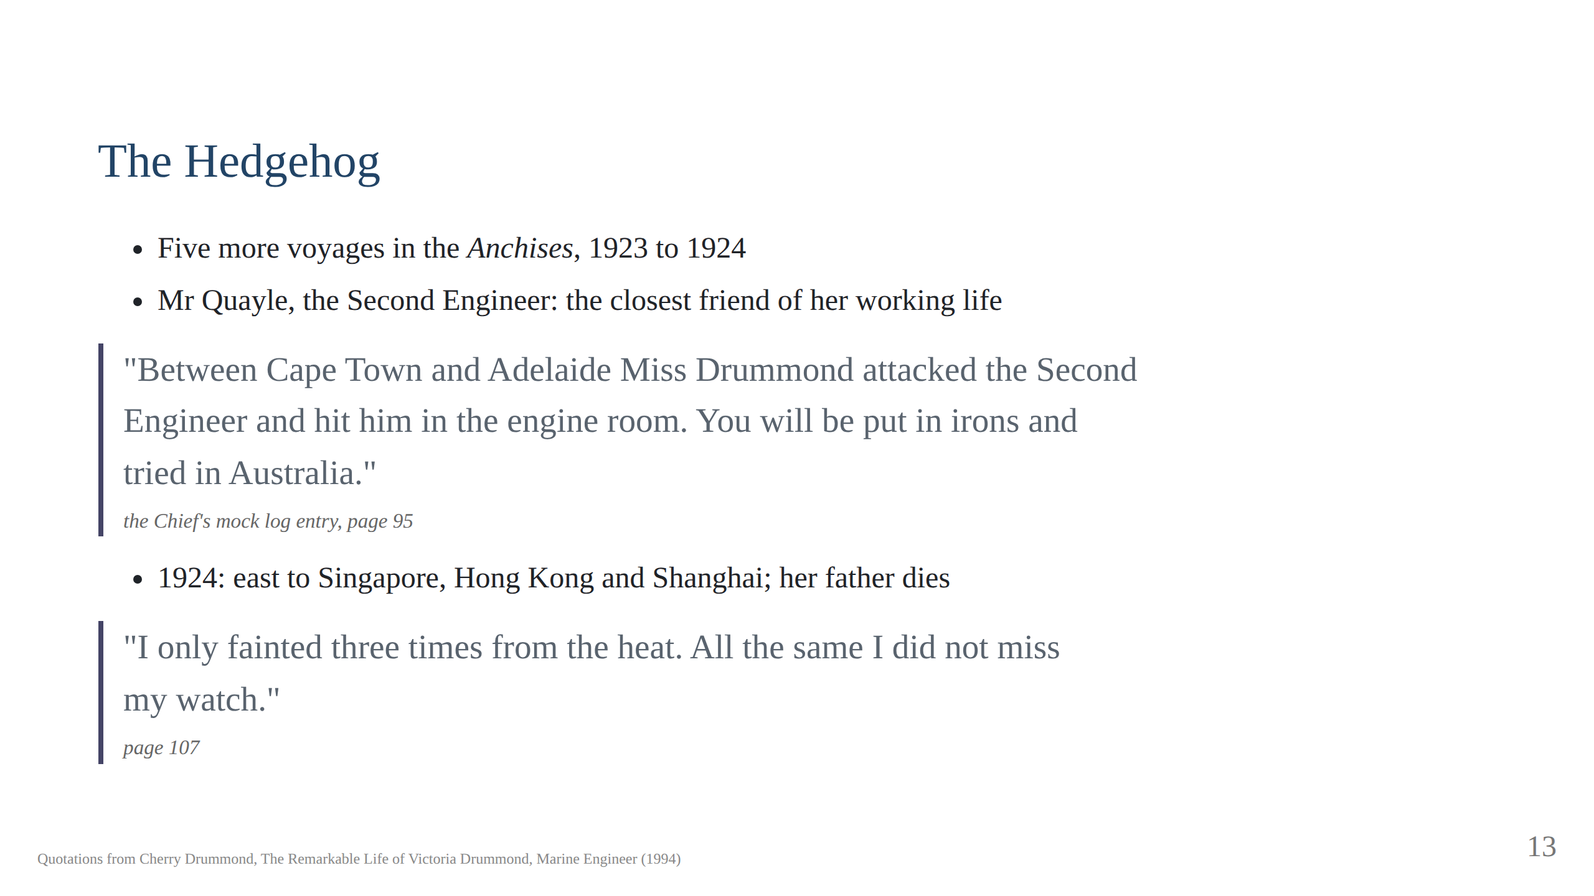
Notes:
She made five more voyages in the Anchises. The Second Engineer, Mr
Quayle, whom she called the Hedgehog, became the closest friend of her
working life. He was a standout perons He teased her without mercy. The Chief once wrote a mock entry
in the log: "Between Cape Town and Adelaide Miss Drummond attacked the
Second Engineer and hit him in the engine room. You will be put in irons and
tried in Australia." (page 95) The evidence was a scratch from a file.
The 1924 voyage went east, to Singapore, Hong Kong and Shanghai. At
Singapore a telegram told her that her father had died. The engine room
stood at a hundred and six to a hundred and eighteen degrees. "I only
fainted three times from the heat," she wrote. "All the same I did not miss
my watch." (page 107)
They were close friends and he came to stay at Megginch Castle.
Mr Freeman of the Blue Funnel line feared that Mr Quayle and Victoria were too close
and told her that it would be her last voyage.

Slide 14
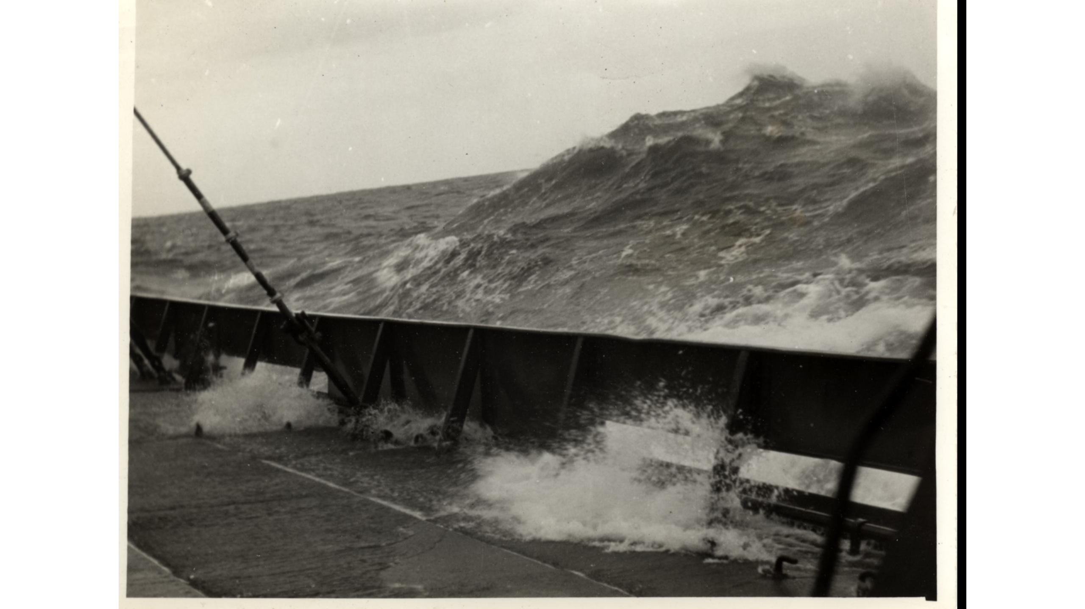
Notes:
A sea coming over the bulwark, photographed from the deck. Let it sit
while the Anchises voyages are told.

Slide 15
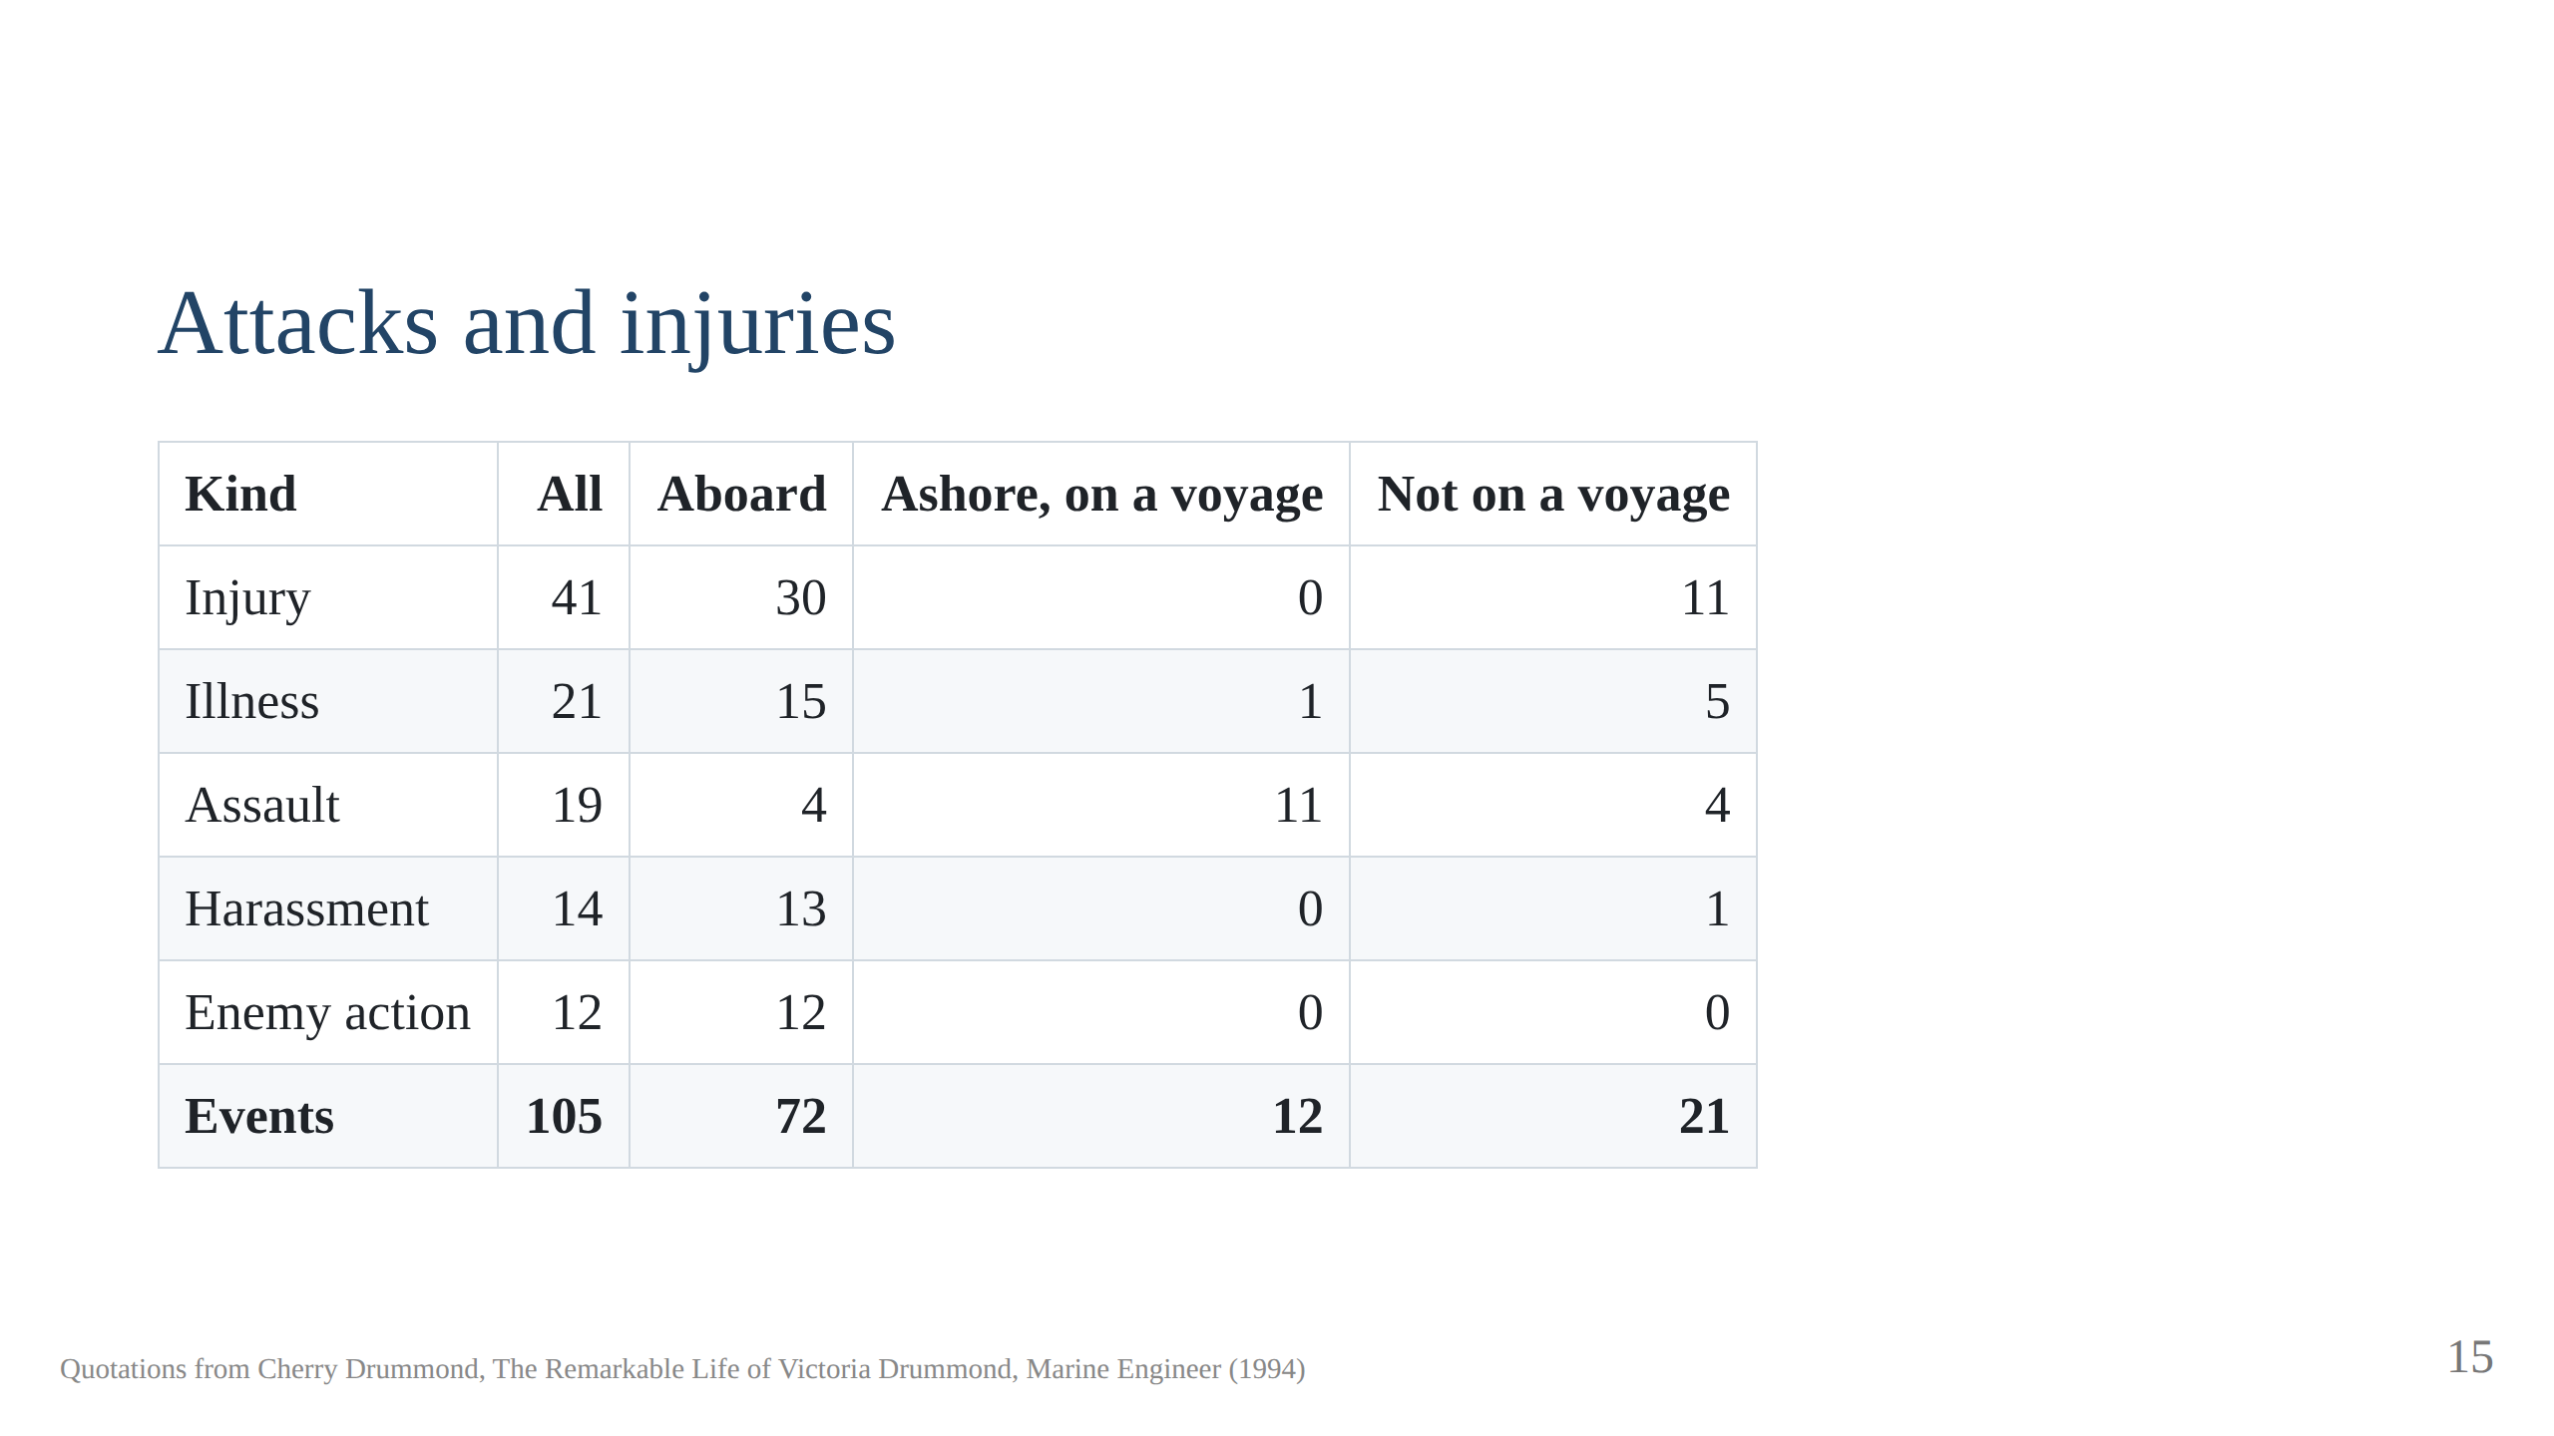
Notes:
Every attack, injury and illness the book records, from childhood to old
age; the archive, build/attacks-and-injuries.pdf from task attacks, has
each with page and quote. The kinds sum
to 107 because two events are both injury and illness. Injury is mostly
engine-room work. Assault is mostly ashore in port, robbery and menace;
aboard, the hostility took the form of harassment. Enemy action is all at
sea, 1940 to 1944.

Slide 16
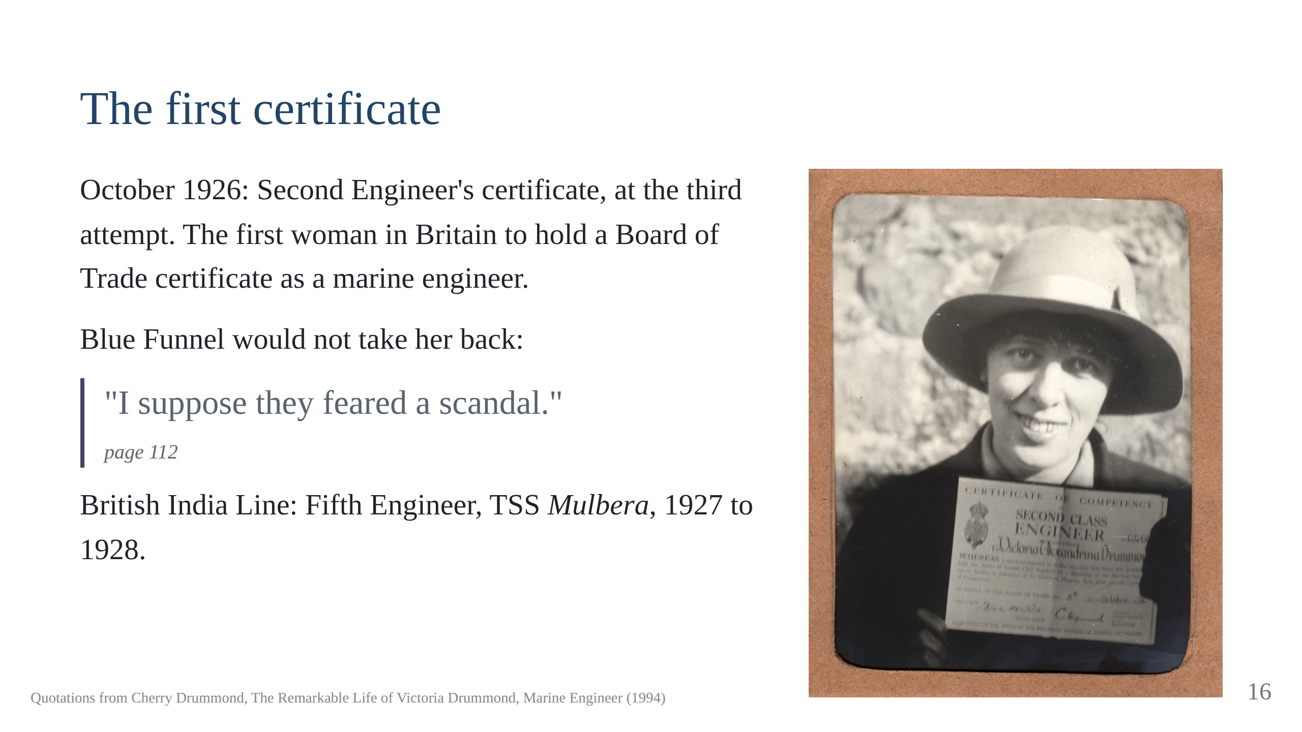
Notes:
At the end of that voyage she asked Blue Funnel for a reference to sit her
Second Engineer's certificate, and they let her go. When she had passed, at
the third attempt, they would not take her back. "It was a great shock to me
that they would not have me. I suppose they feared a scandal." (page 112)
It was a three day exam and she was on the only one in her cohort to pass.
She was now the first woman in Britain to hold a Board of Trade certificate
as a marine engineer. It was October 1926, the month she turned thirty-two.
Next, the Mulbera's map, and the Tiger, Mr Lamb. Script section 5.

Slide 17
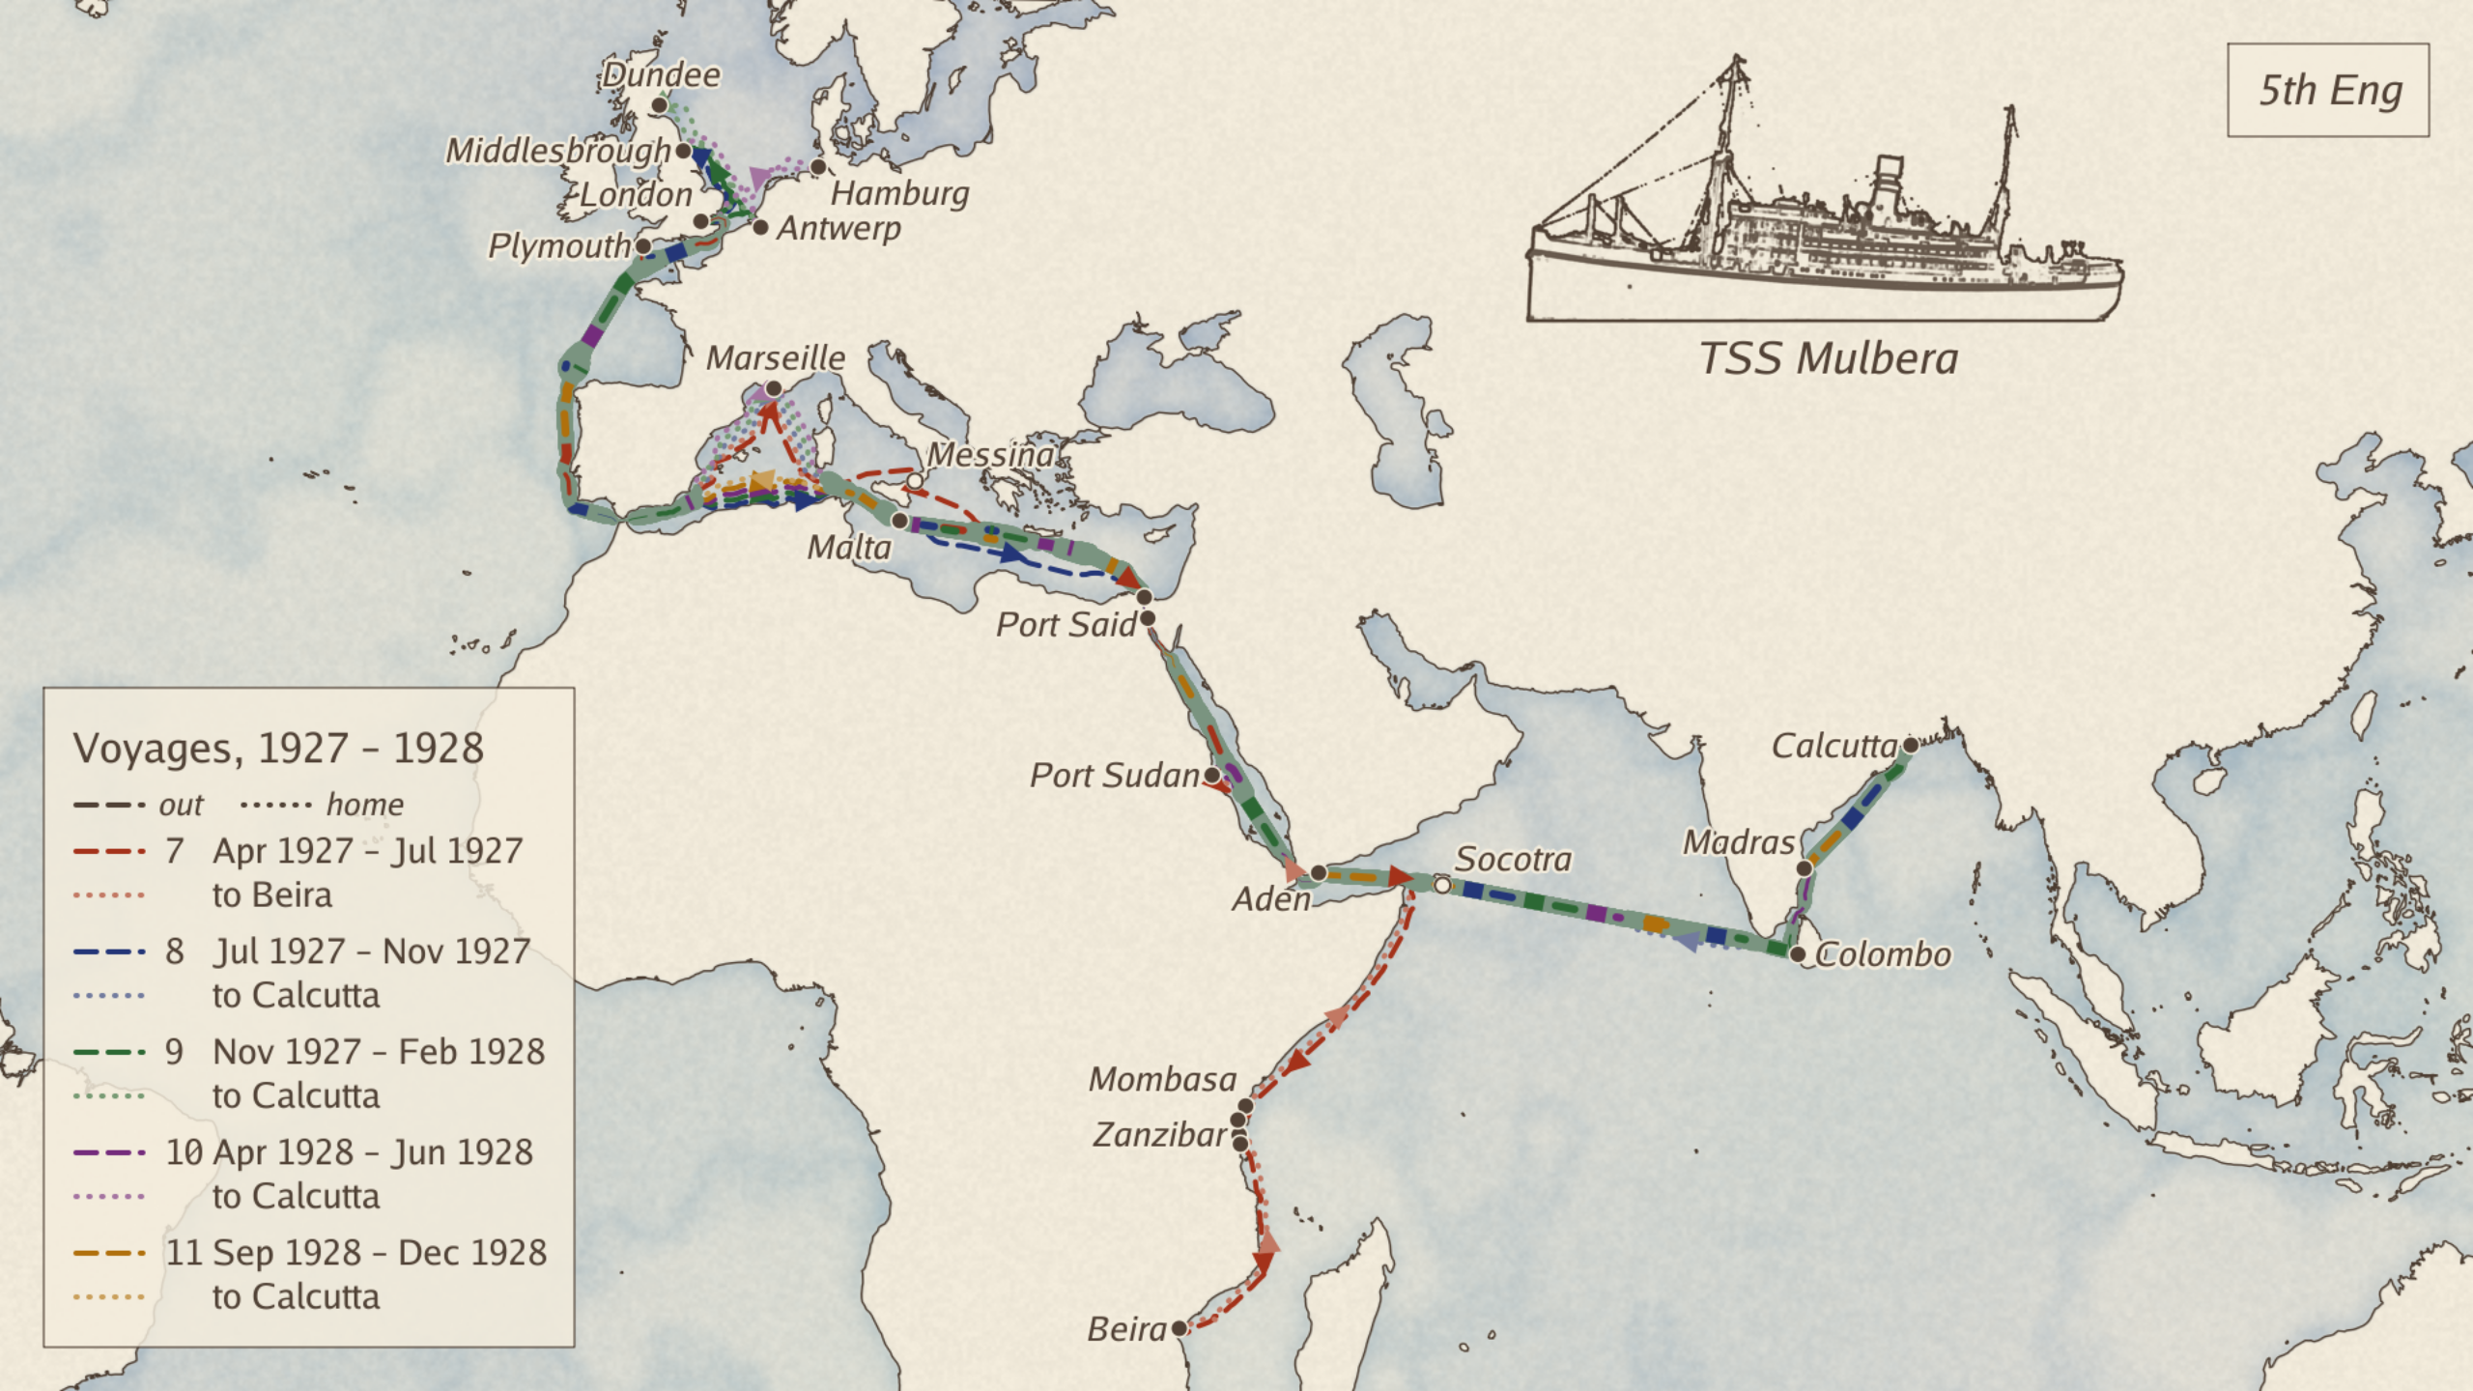
Notes:
The Tiger: Mr Lamb, Second Engineer of the Mulbera, April 1927 to
December 1928. The book never says outright that the Tiger is Mr Lamb;
the name first appears as "Tiger Cat" on page 123, in a paragraph about
"the Second", and from then the two names are used in one breath
(page 139).
For a voyage he was helpful: called her up to see Stromboli, lent her his
green glasses in the glare at Port Sudan, let her off watch for the
crossing of the Line (pages 114 to 118). Then, homeward through Malta:
"a wolf in sheep's clothing. He told me on the first day that he didn't
want me there and since then had been alternately kind or nasty, often
saying things against my work to the others. Once or twice he swore at me
and he was always shouting at me, which wore down my nerves." (page 121)
His weapon was the Second's say over her work, never an open fight: night
work in every Indian port, an 84 hour week in Calcutta with about fifteen
days of nights and no sleep possible by day (pages 135 to 136, 141); the
worst job in the worst weather, brass strips on the turbine casing in a
Biscay gale while he lay seasick (page 133); shore leave refused or given
rudely (pages 143, 145); stories about her spread to the others, so that
she dared not ask for leave at home (page 140). He hid from the Chief a
piece of jointing the London shore staff had forced into the LP turbine
casing, and came round "at white heat" when she mentioned it; the Chief
said she was right to, there could have been serious consequences
(page 131).
Two men checked him: Mr Stuart, the Chief, who took her to dine ashore in
Calcutta over his row and told her to come to him if the Second was rude
again (pages 128, 145); and a Governor's nephew at Madras, Captain
Goschen, who "got it fixed up with the Tiger" (page 149). Once, to her
surprise, he found her a passenger cabin with two fans to sleep in: "I
suspected they had been going at him for treating me unfairly."
(page 142)
Leaving, December 1928: "if it had not been for the terrible Tiger and
the lack of leave when we came home, perhaps I would have stayed on her
longer." (page 149) Thirty years on, in the Shun Fung at Suez: "in the
Mulbera with the Tiger I had thought, 'Some day I shall go through the
Canal as Chief.' And now there were so many times that I had."
(page 319)

Slide 18
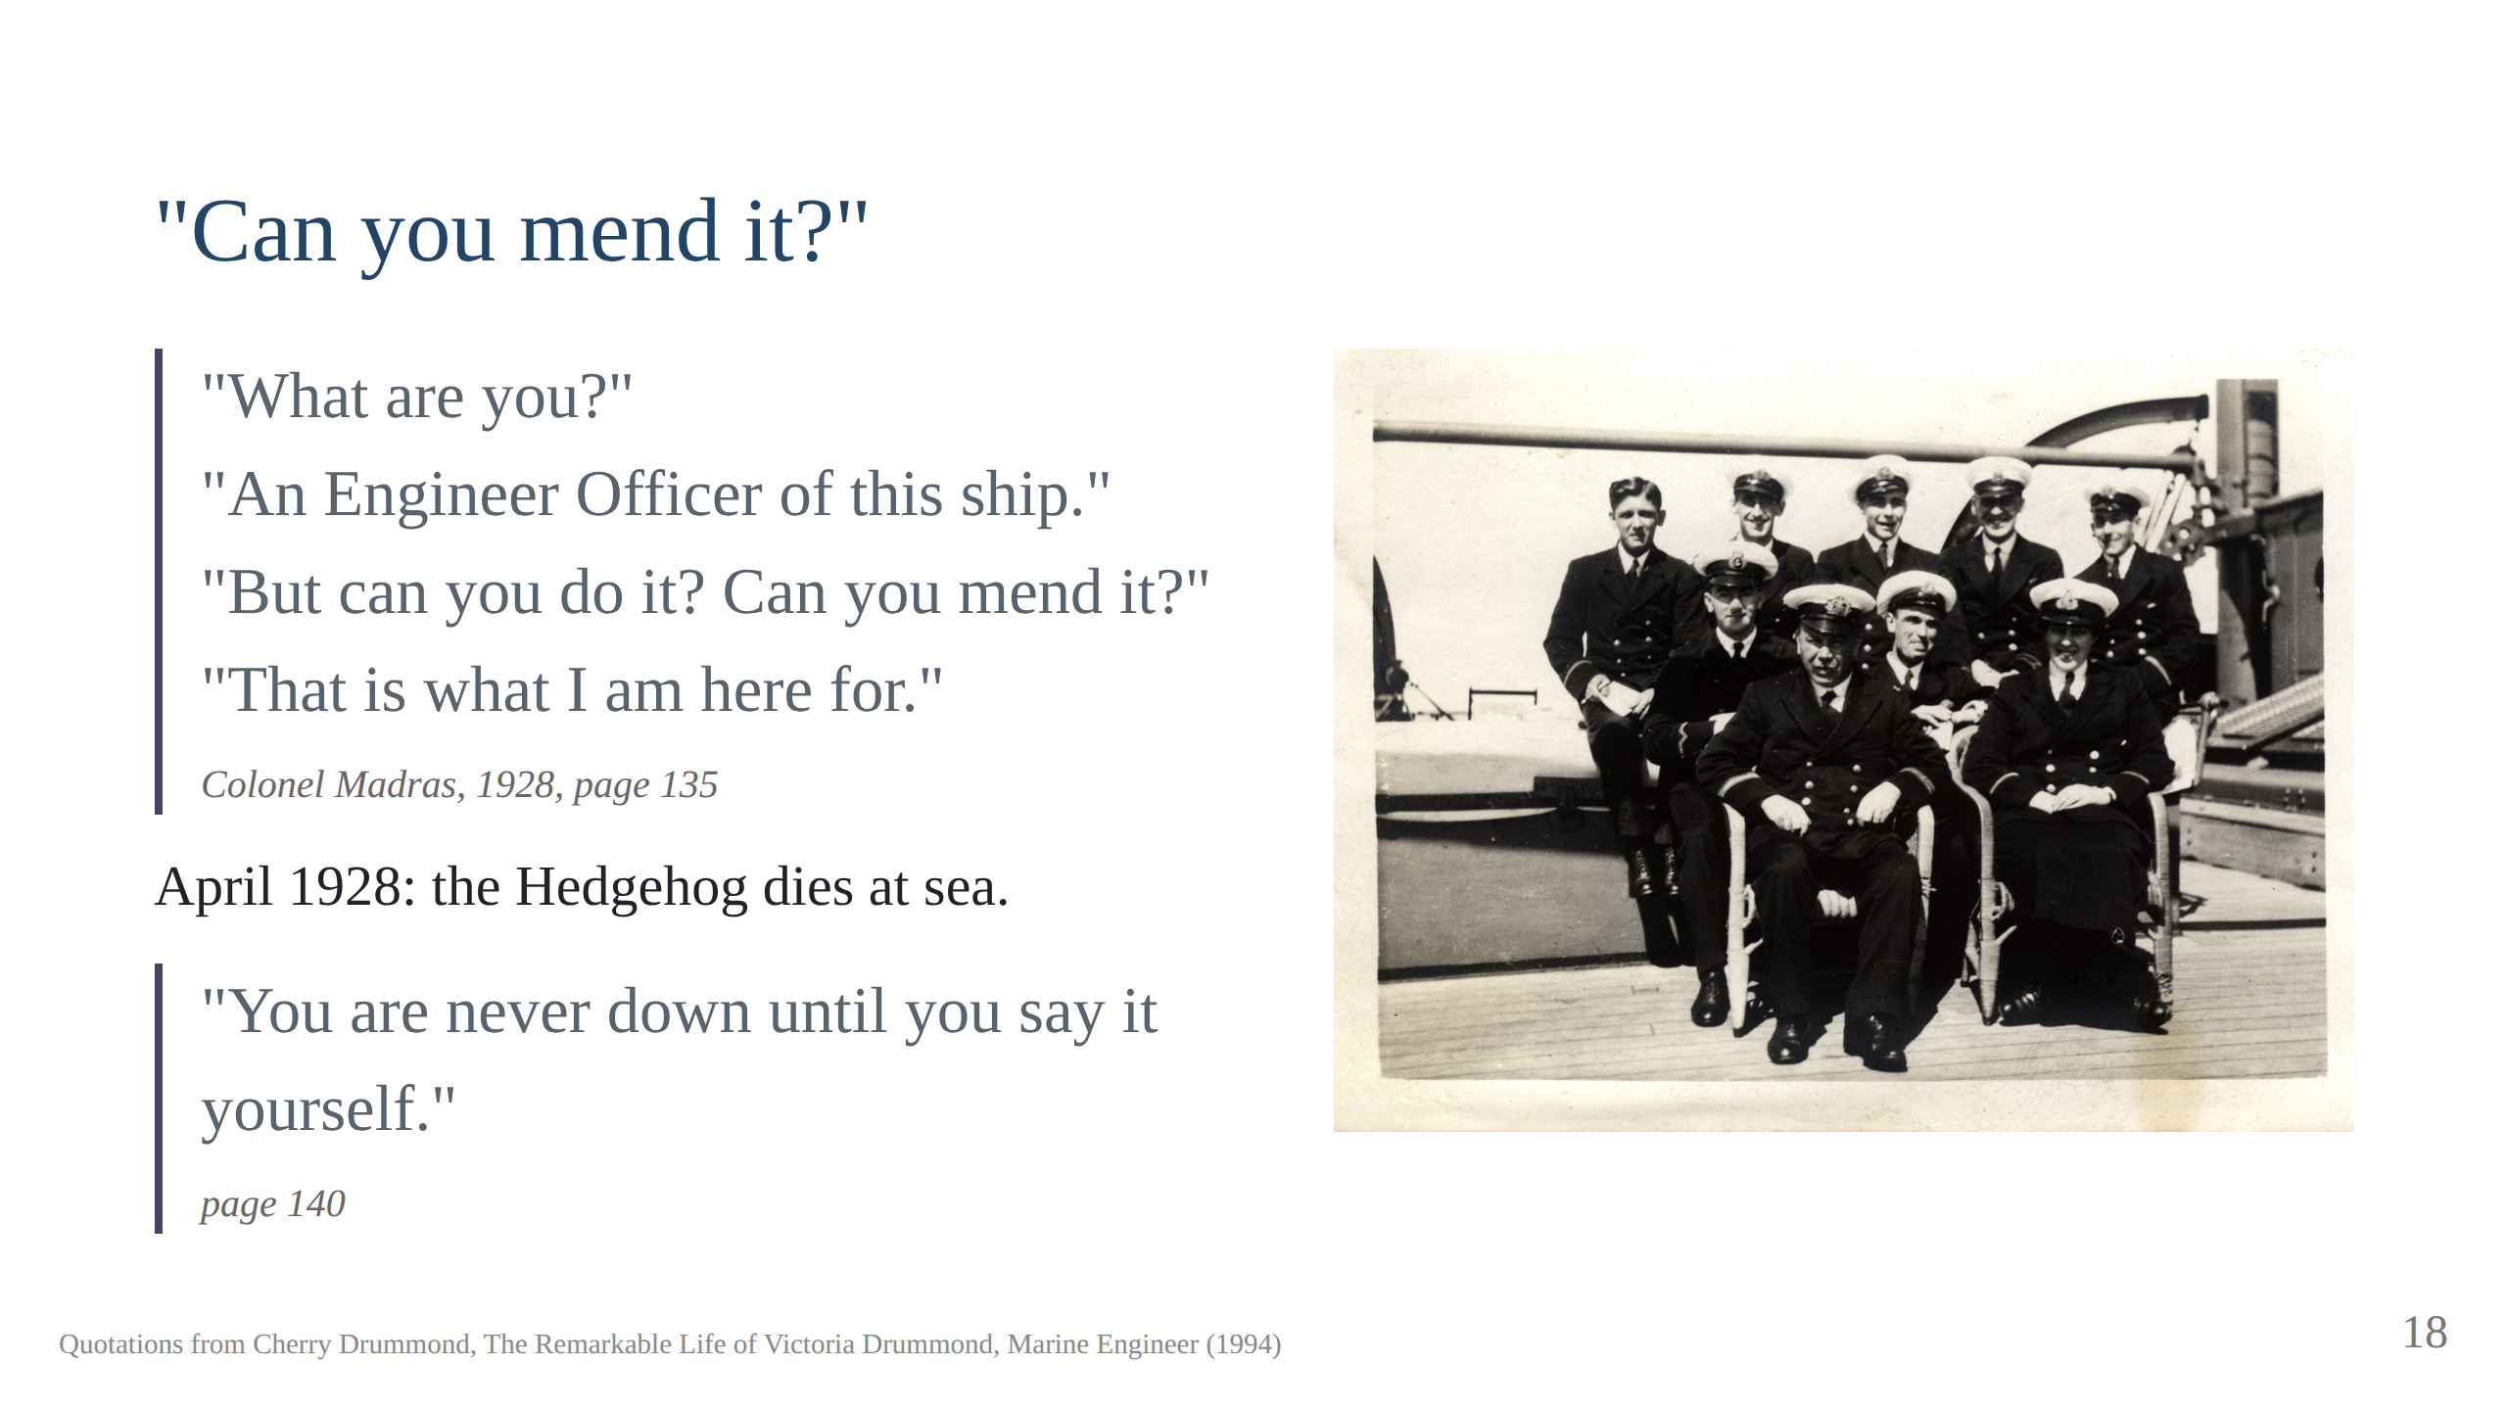
Notes:
About midnight in Madras I was sent for to repair a passenger’s fan and light. When I was in the middle of doing this the passenger, an old very irate Indian Colonel, came in and demanded, “What are you?”
I replied, “An Engineer Officer of this ship.”
He said, “But can you do it? Can you mend it?”
I said, “That is what I am here for.”
He then became very polite and explained that he had been chasing mosquitoes with his bath towel.
She left the Mulbera in December 1928 with the sea time for a Chief's
certificate and a reference calling her "of exemplary character".

Slide 19
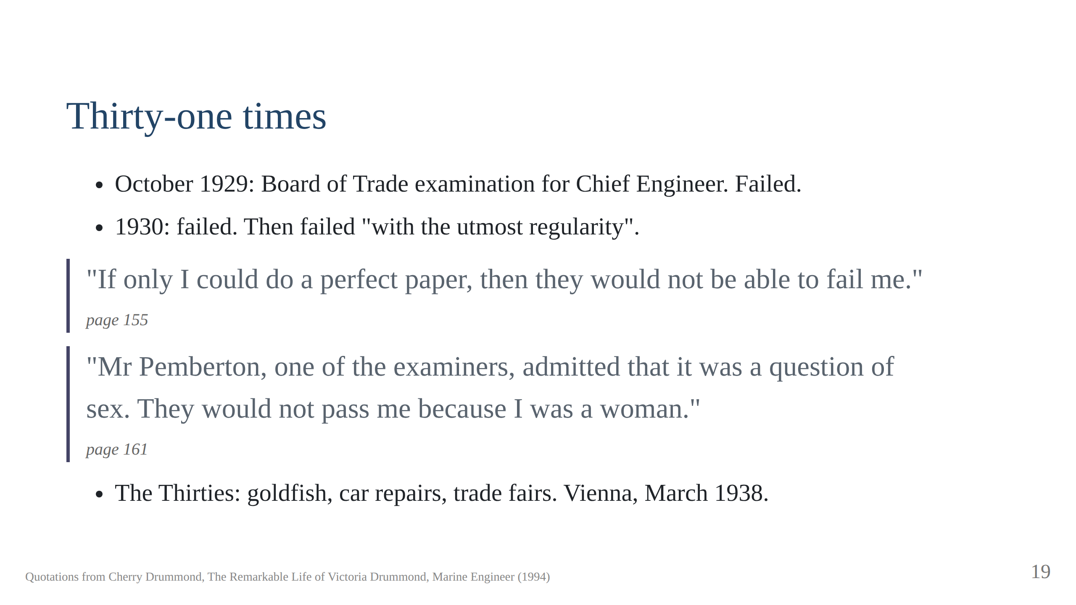
Notes:
Golden Fisheries at 143 Kennington Road with Frances. The Anschluss: she
refused the salute and hit a soldier with "my strong left hand". "There
were so many people, we did not know which one he was." Script section 6.

Slide 20
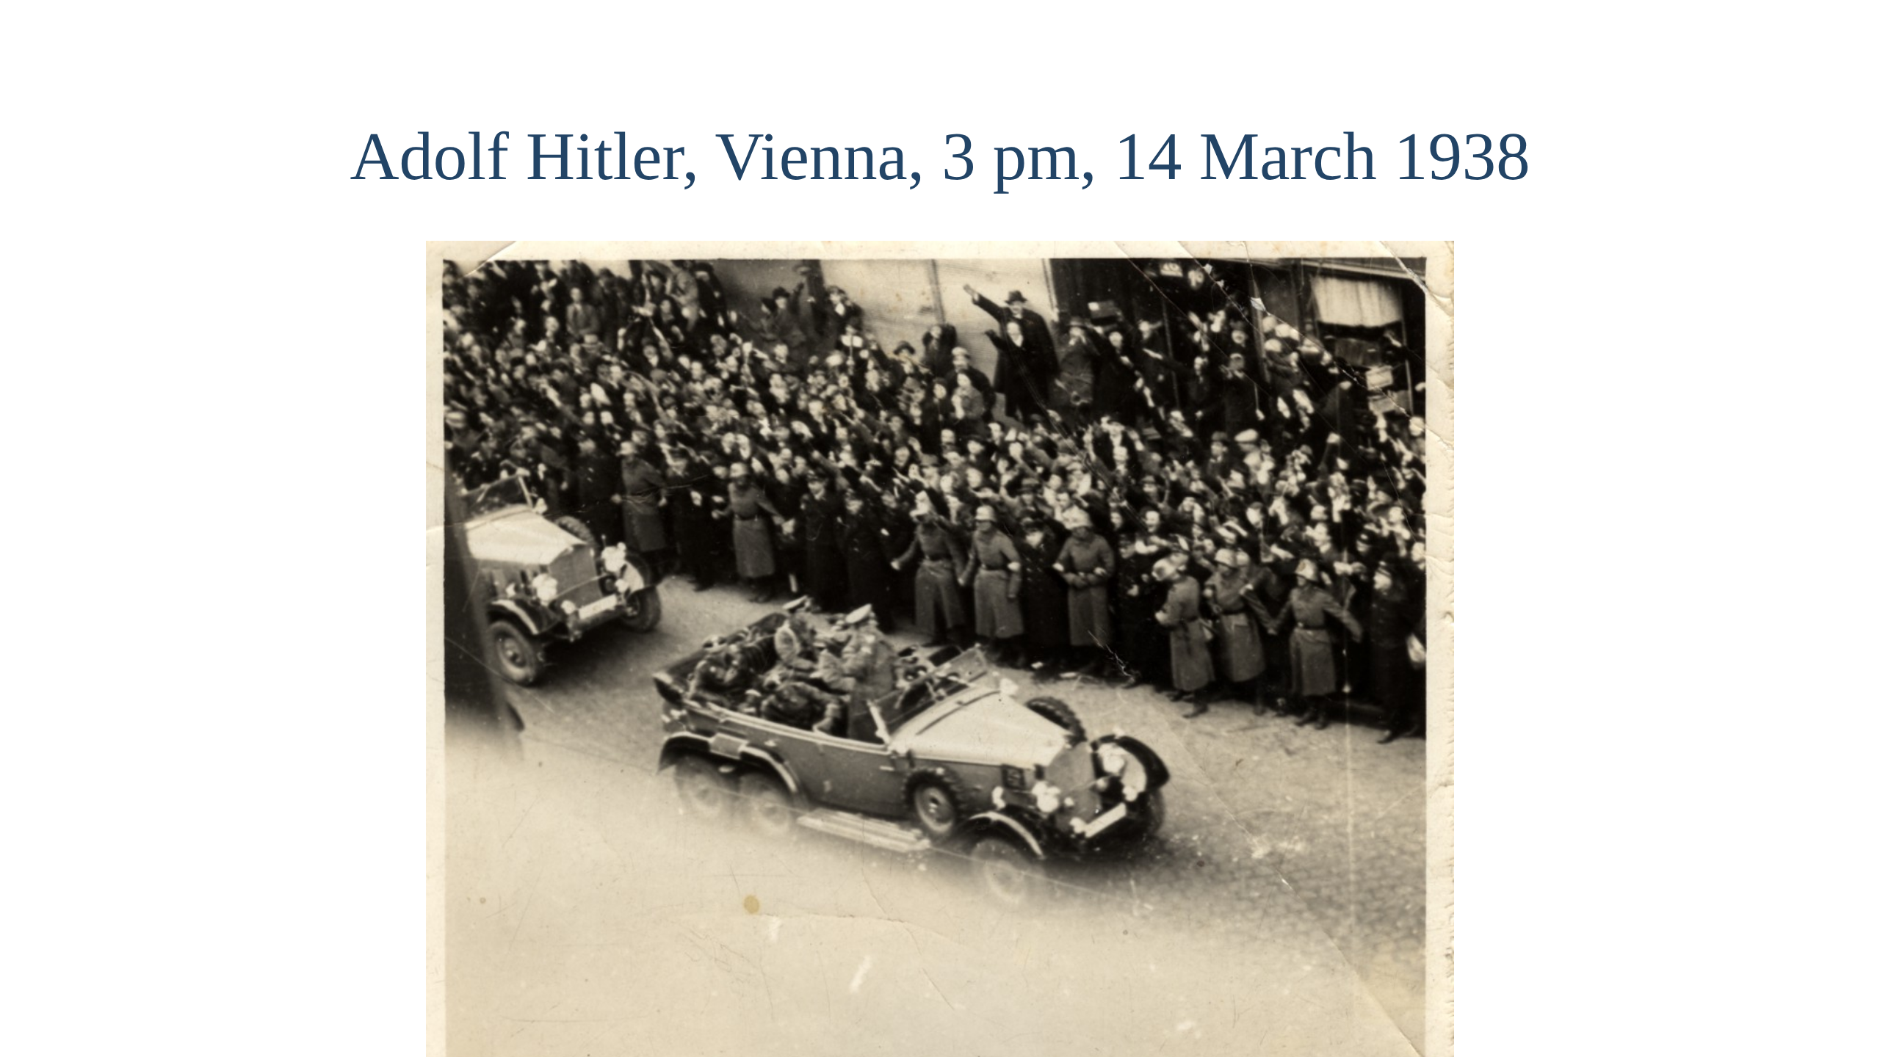
Notes:
Hitler enters Vienna, Monday 14 March 1938, photographed by Victoria
leaning out with Frances holding her legs. The trip, from the book:
February 1938: commissions for the fairs at Leipzig, Prague and Vienna,
enough to pay for the trip. Page 162.
Early March: Hook boat to Dresden, Hotel Union, the Leipzig fair daily.
Page 162.
Tuesday 8 March: Prague in falling snow. She buys in machine tools,
Frances in textiles. Page 163.
Friday 11 March: afternoon train to Vienna; the crowd demands the salute
and they refuse. Pages 163 to 164.
Saturday 12 March: German troops cross the border; Goebbels on the
wireless. Pages 165 to 167.
Sunday 13 March: the Vienna fair opens, "a complete flop"; Frances spends
her schillings before the mark comes in. Page 168.
Monday 14 March: Hitler drives past at about 3 pm; the Hook Express home
that night. Pages 169 to 170.

Slide 21
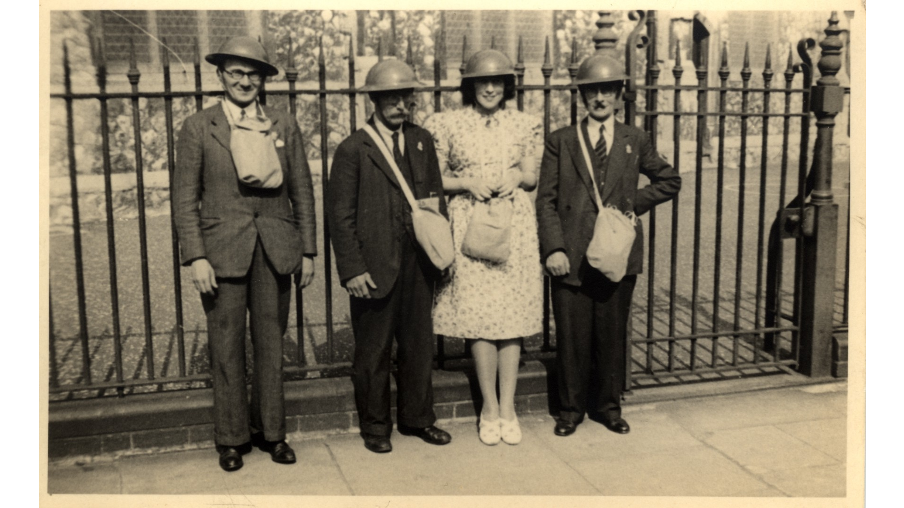
Notes:
When the war started she did her bit and became an air raid warden. She talked to the Board of
Trade trying to get a job but failed to get anywhere. She
still hankered after the sea and hand round the docks. In a cafe she was hailed;
"Hello Fifth", it was the donkeyman from the Mulbera. The donkeyman was the engineer
who had sole charge of the small auxiliary engine. They caught up and he said
"If the Red Duster won't have you, go foreign.", meaning the if you can't get a ship get a ship with a foreign registration. He introduced her
to the owner of a number of small tramp ships and she was immediately engaged on the Har Zion first, later lost
with all hands but one. Naval inspectors "amazed and disgusted". Script
section 7.

Slide 22
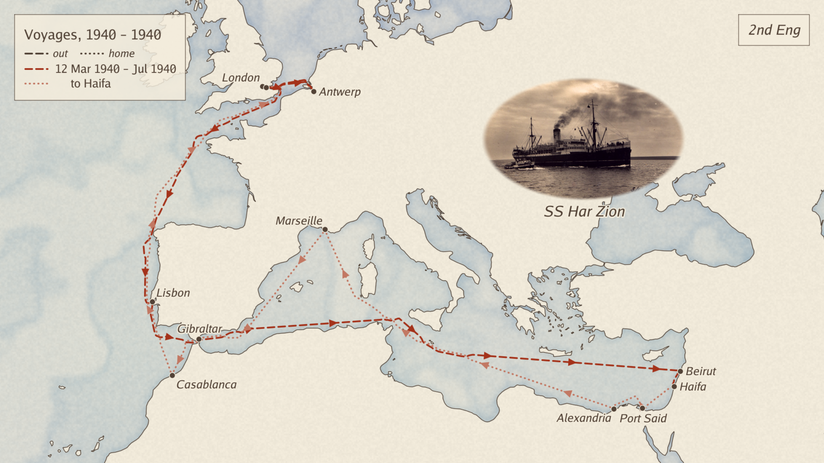

Slide 23
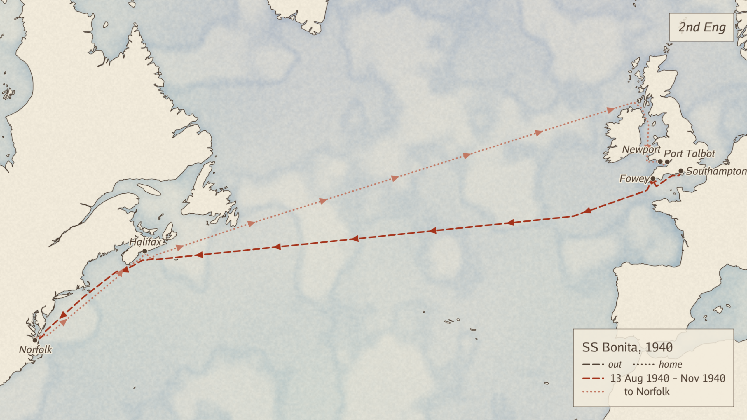

Slide 24
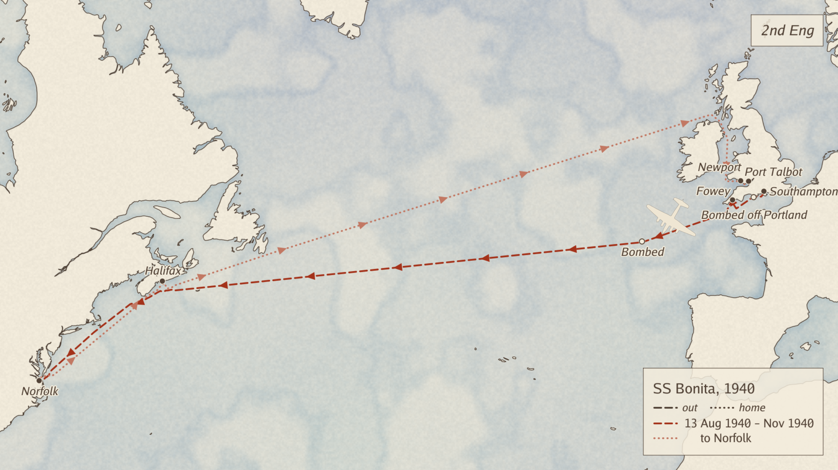

Slide 25
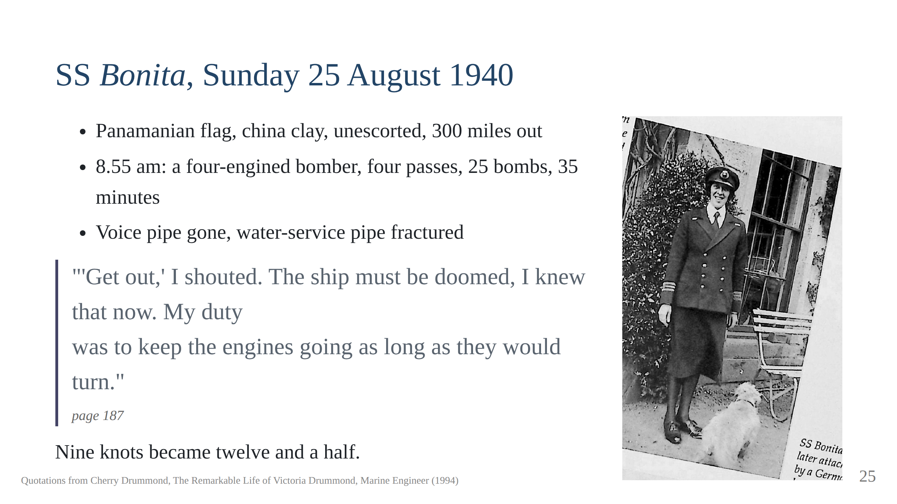
Notes:
As a talented engineer she was able to get the absolute best out of these engines.

Slide 26
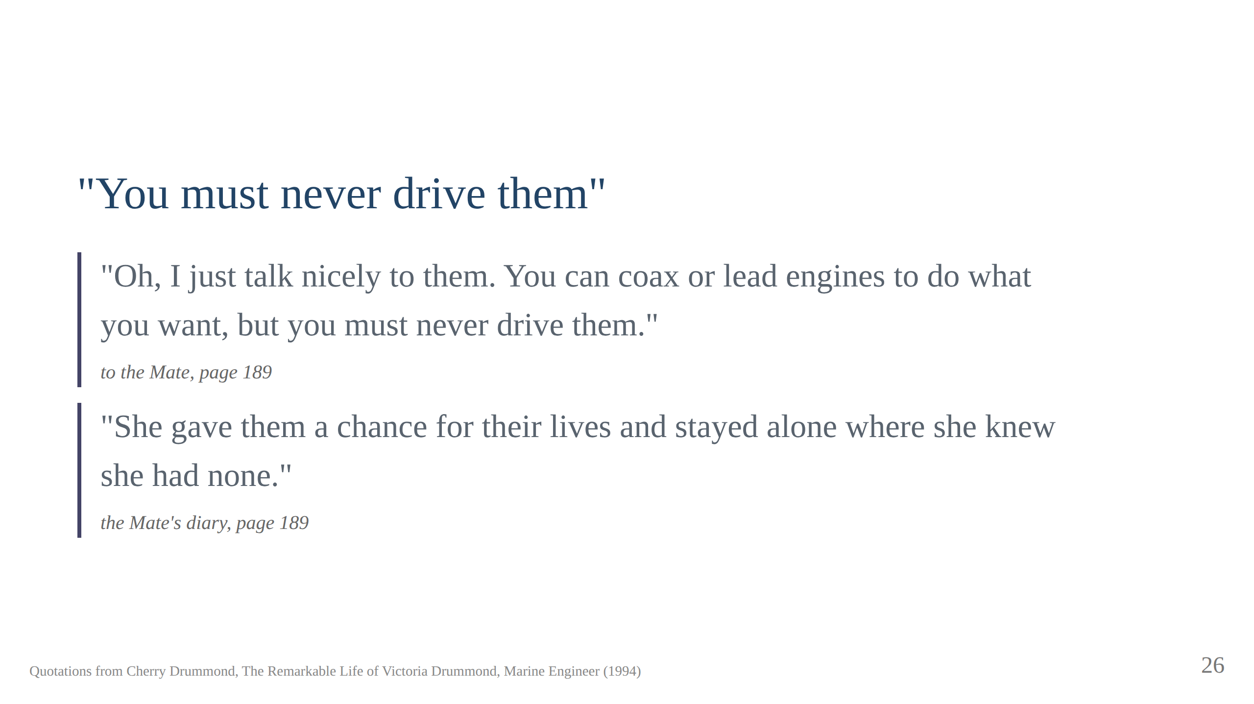
Notes:
She was a great engineer and coaxed 12.5 knots out of this ship which was its faster recorded speed

Slide 27
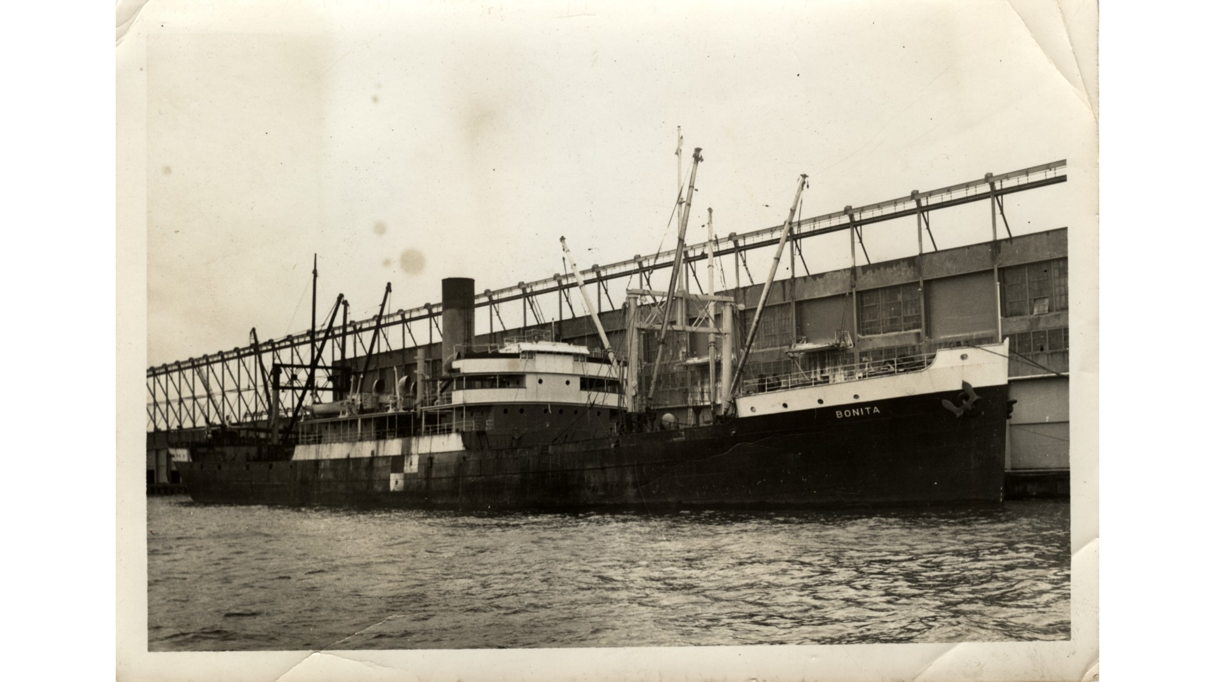

Slide 28
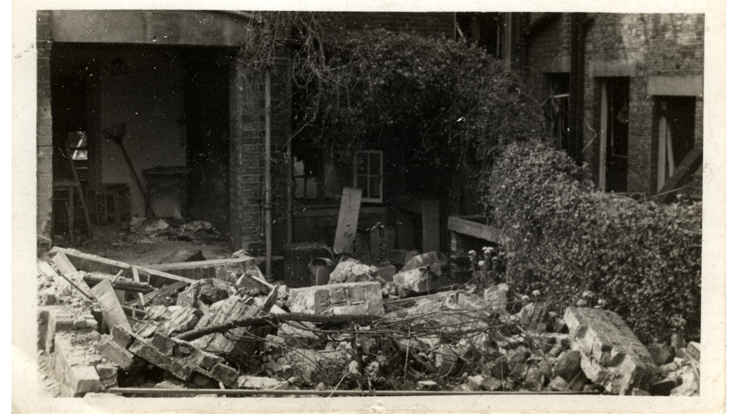
Notes:
While in Norfolk her sisters house was bombed, luckily they were out of the house. The goldfish were
also unharmed and transferred to their cousin Maurice Drummond Head of Scotland Yard for safe keeping.

Slide 30
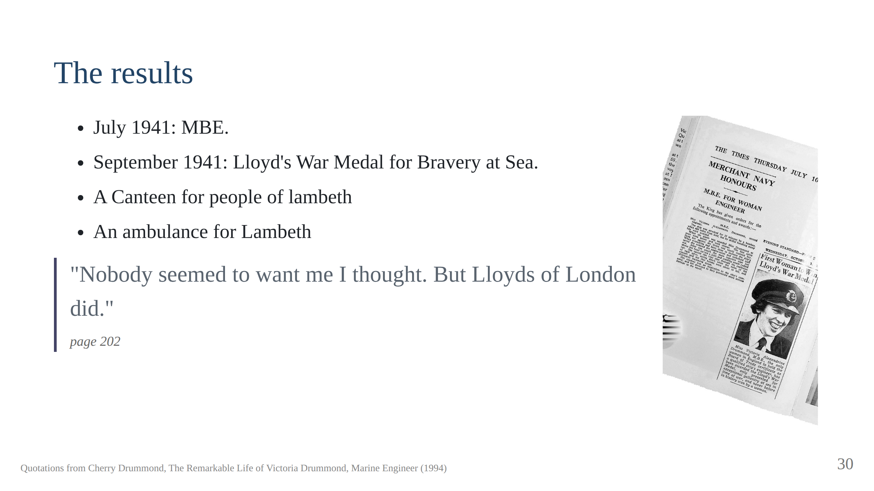
Notes:
Home in a
convoy of 39 ships from Halifax; four arrived.

Slide 31
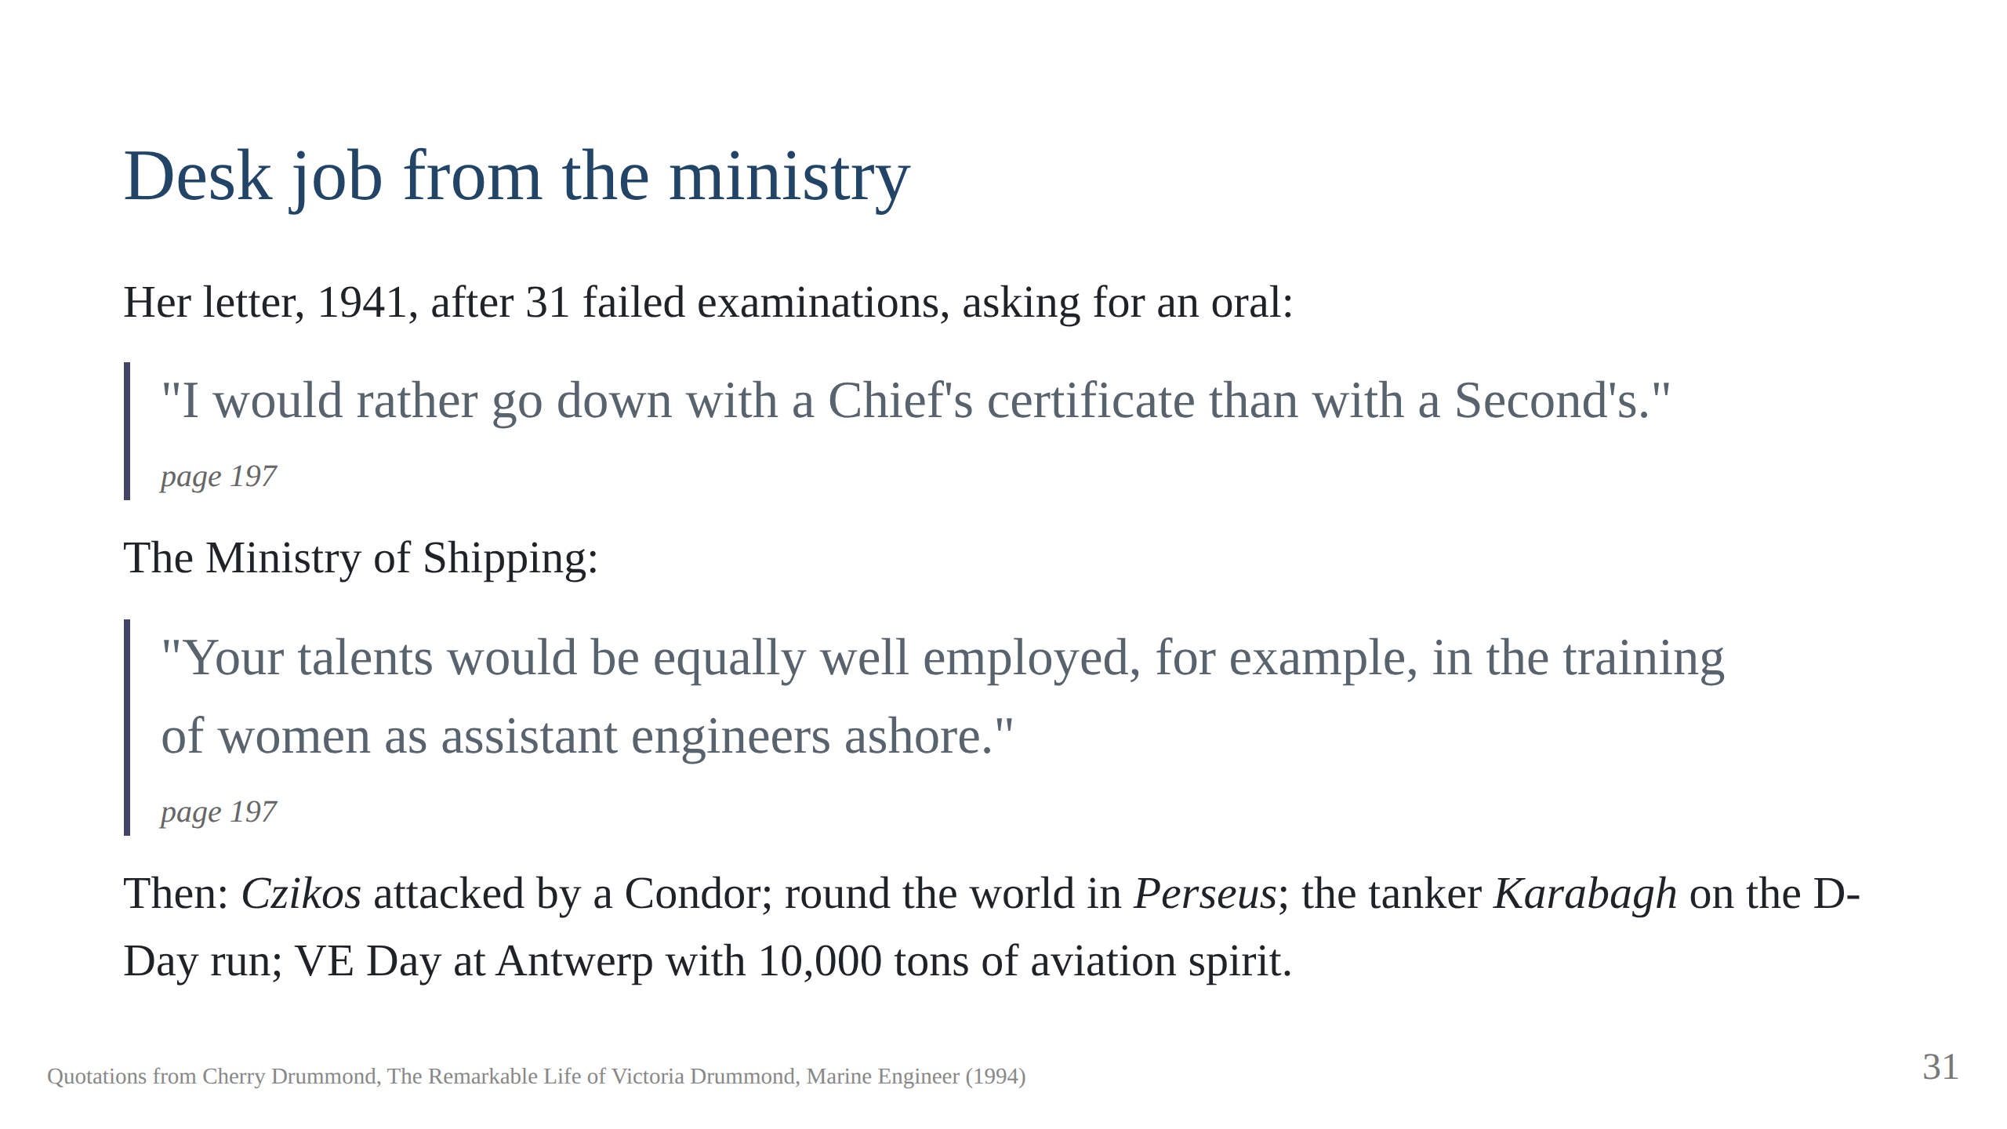
Notes:
"You would make a fine bonfire!" Captain Charlton: "Well done, Miss
Drummond." She was pleased to have survived the war.

Slide 32
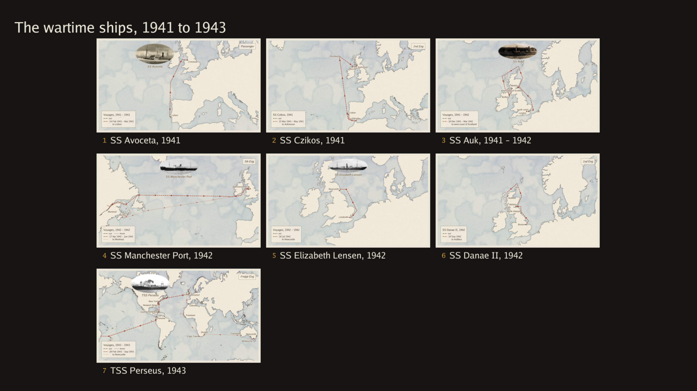

Slide 33
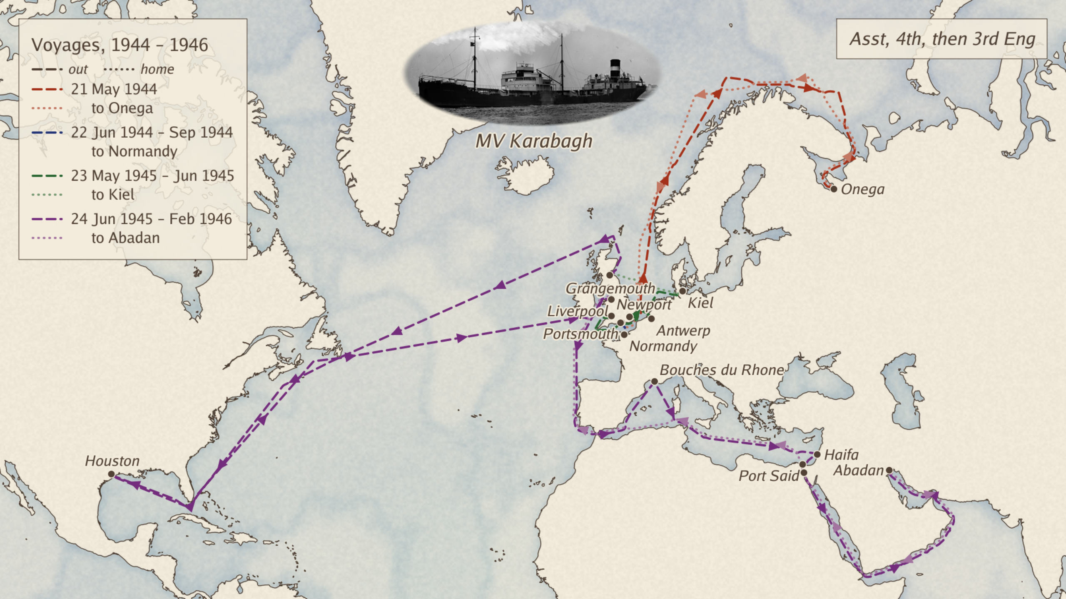
Notes:
The tanker Karabagh, 1944 to 1946, on her own map: Tilbury to Onega on
the White Sea, home to Portsmouth by May 1944; the D-Day run, Portsmouth
and the Isle of Wight to the Normandy beachhead, June to September 1944;
Newport to Antwerp for VE Day, then Kiel and Grangemouth; and the last
voyage, Houston, Liverpool, the Bouches du Rhone, Haifa, through the
Canal to Abadan and home to Liverpool, February 1946.

Slide 34
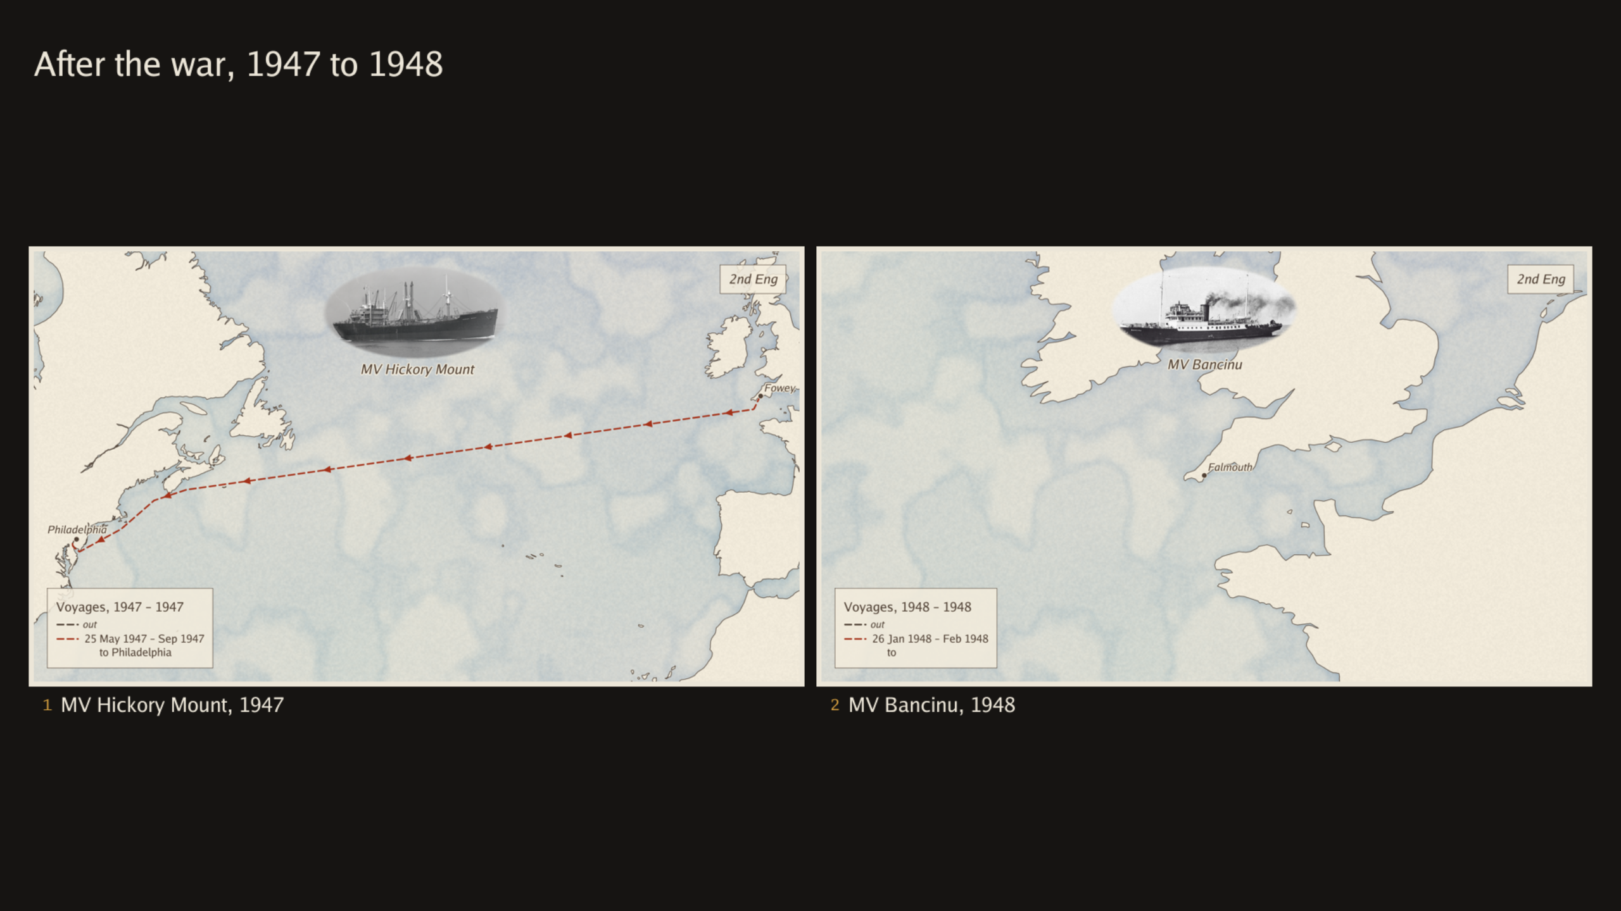
Notes:
Hickory Mount. Remained in the US. Came back on the Acquitania. Very long 46 hour journey with water and no food with the Mate and 57 Indian crew who were unscrewing everything they could find as souvenirs.
MV Bancinu very small, more tug sized as second engineer. Spent a month but broke her wrist before setting off.

Slide 35
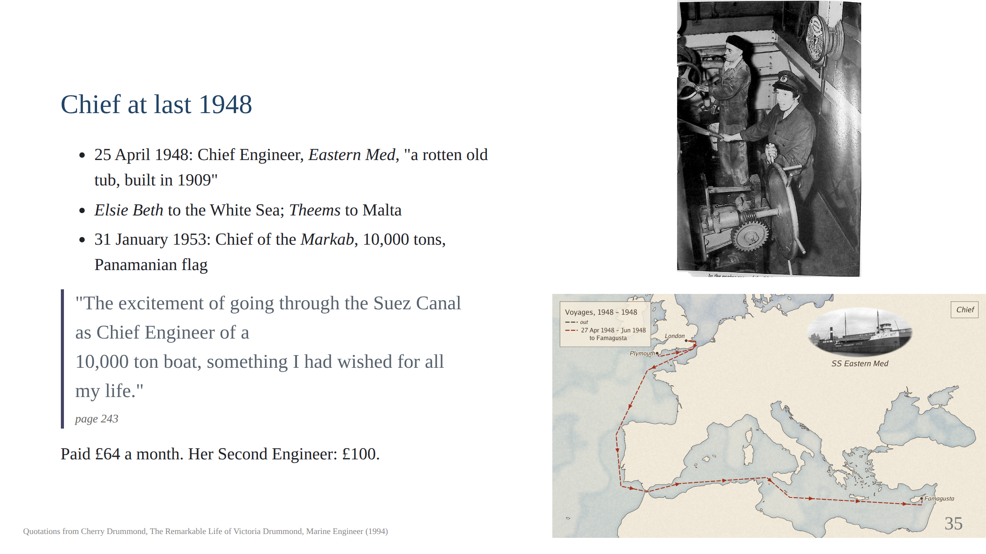
Notes:
She had passed the Panamanian Board of Trade Chiefs exam which
had the advantage of not having her name or secon on the exam paper.
In 1956 she gave up the examination for good, page 280. Script section 8.

Slide 36
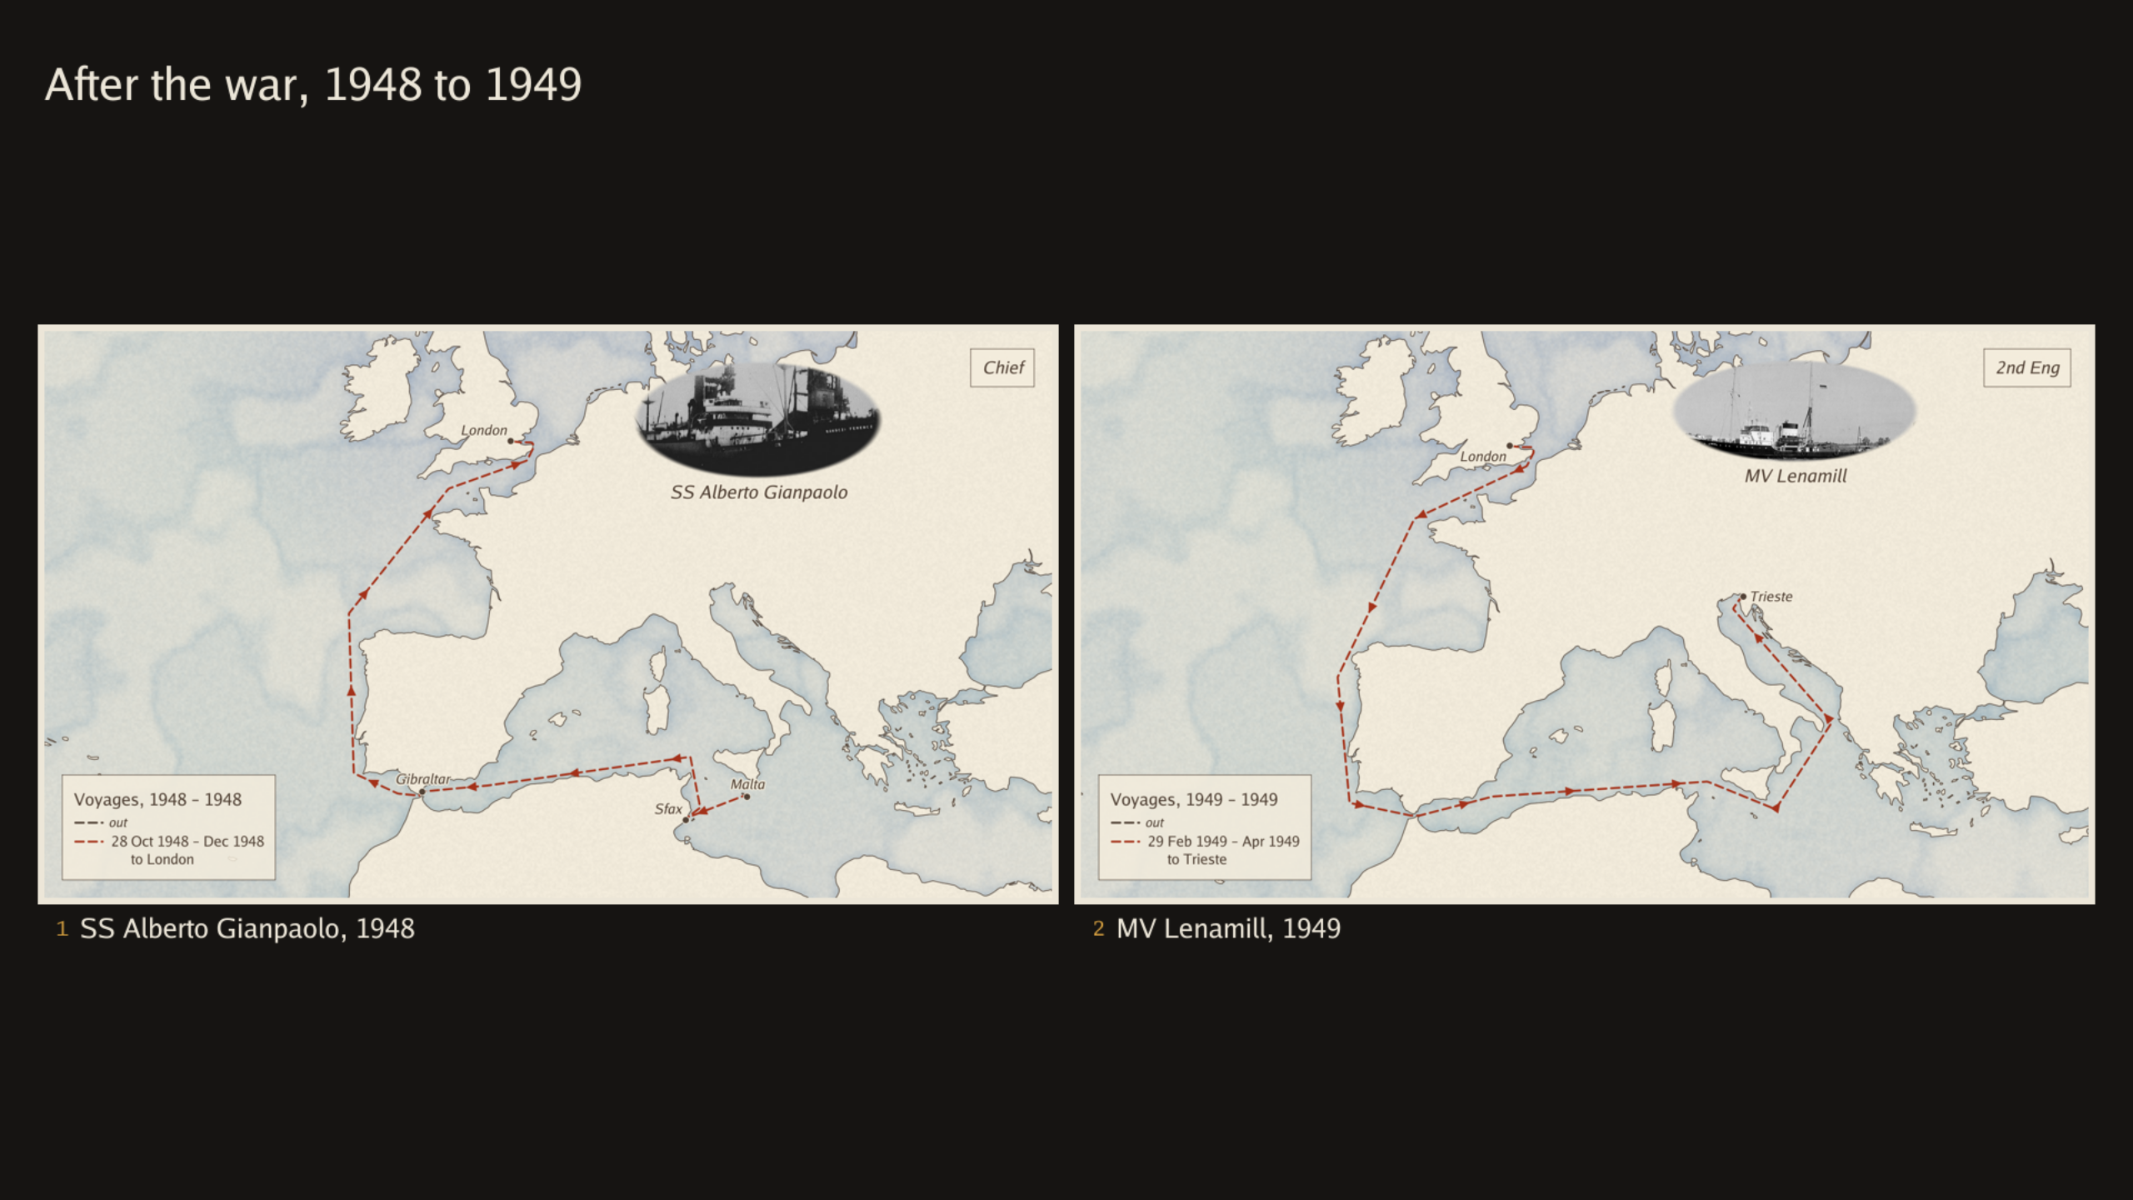
Notes:
The MV Lenamill Chief: "I hate having you here". "All right, get another
Second." The hurricane with 9,000 tons of iron ore.

Slide 37
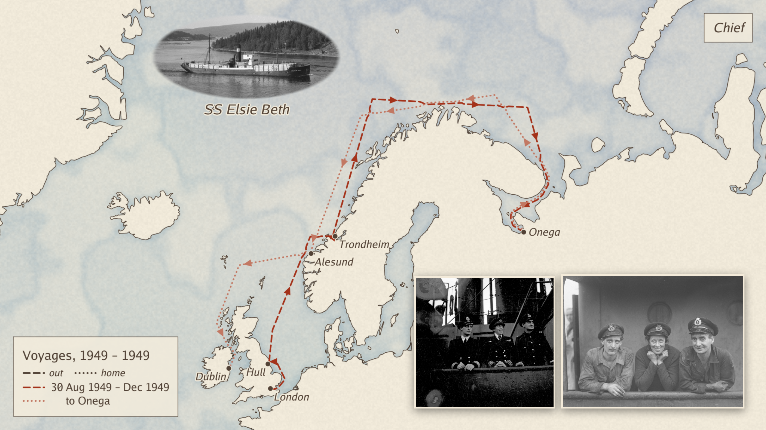
Notes:
The Elsie Beth, August to December 1949: London, Hull, Trondheim, Onega
on the White Sea, where she got frostbite, Alesund, Dublin. The two
photographs are of the ship's crew at Trondheim in 1949, by Schrøder,
Sverresborg Trøndelag Folkemuseum; the museum names but we have.
I like this this picture as she looks so happy.

Slide 38
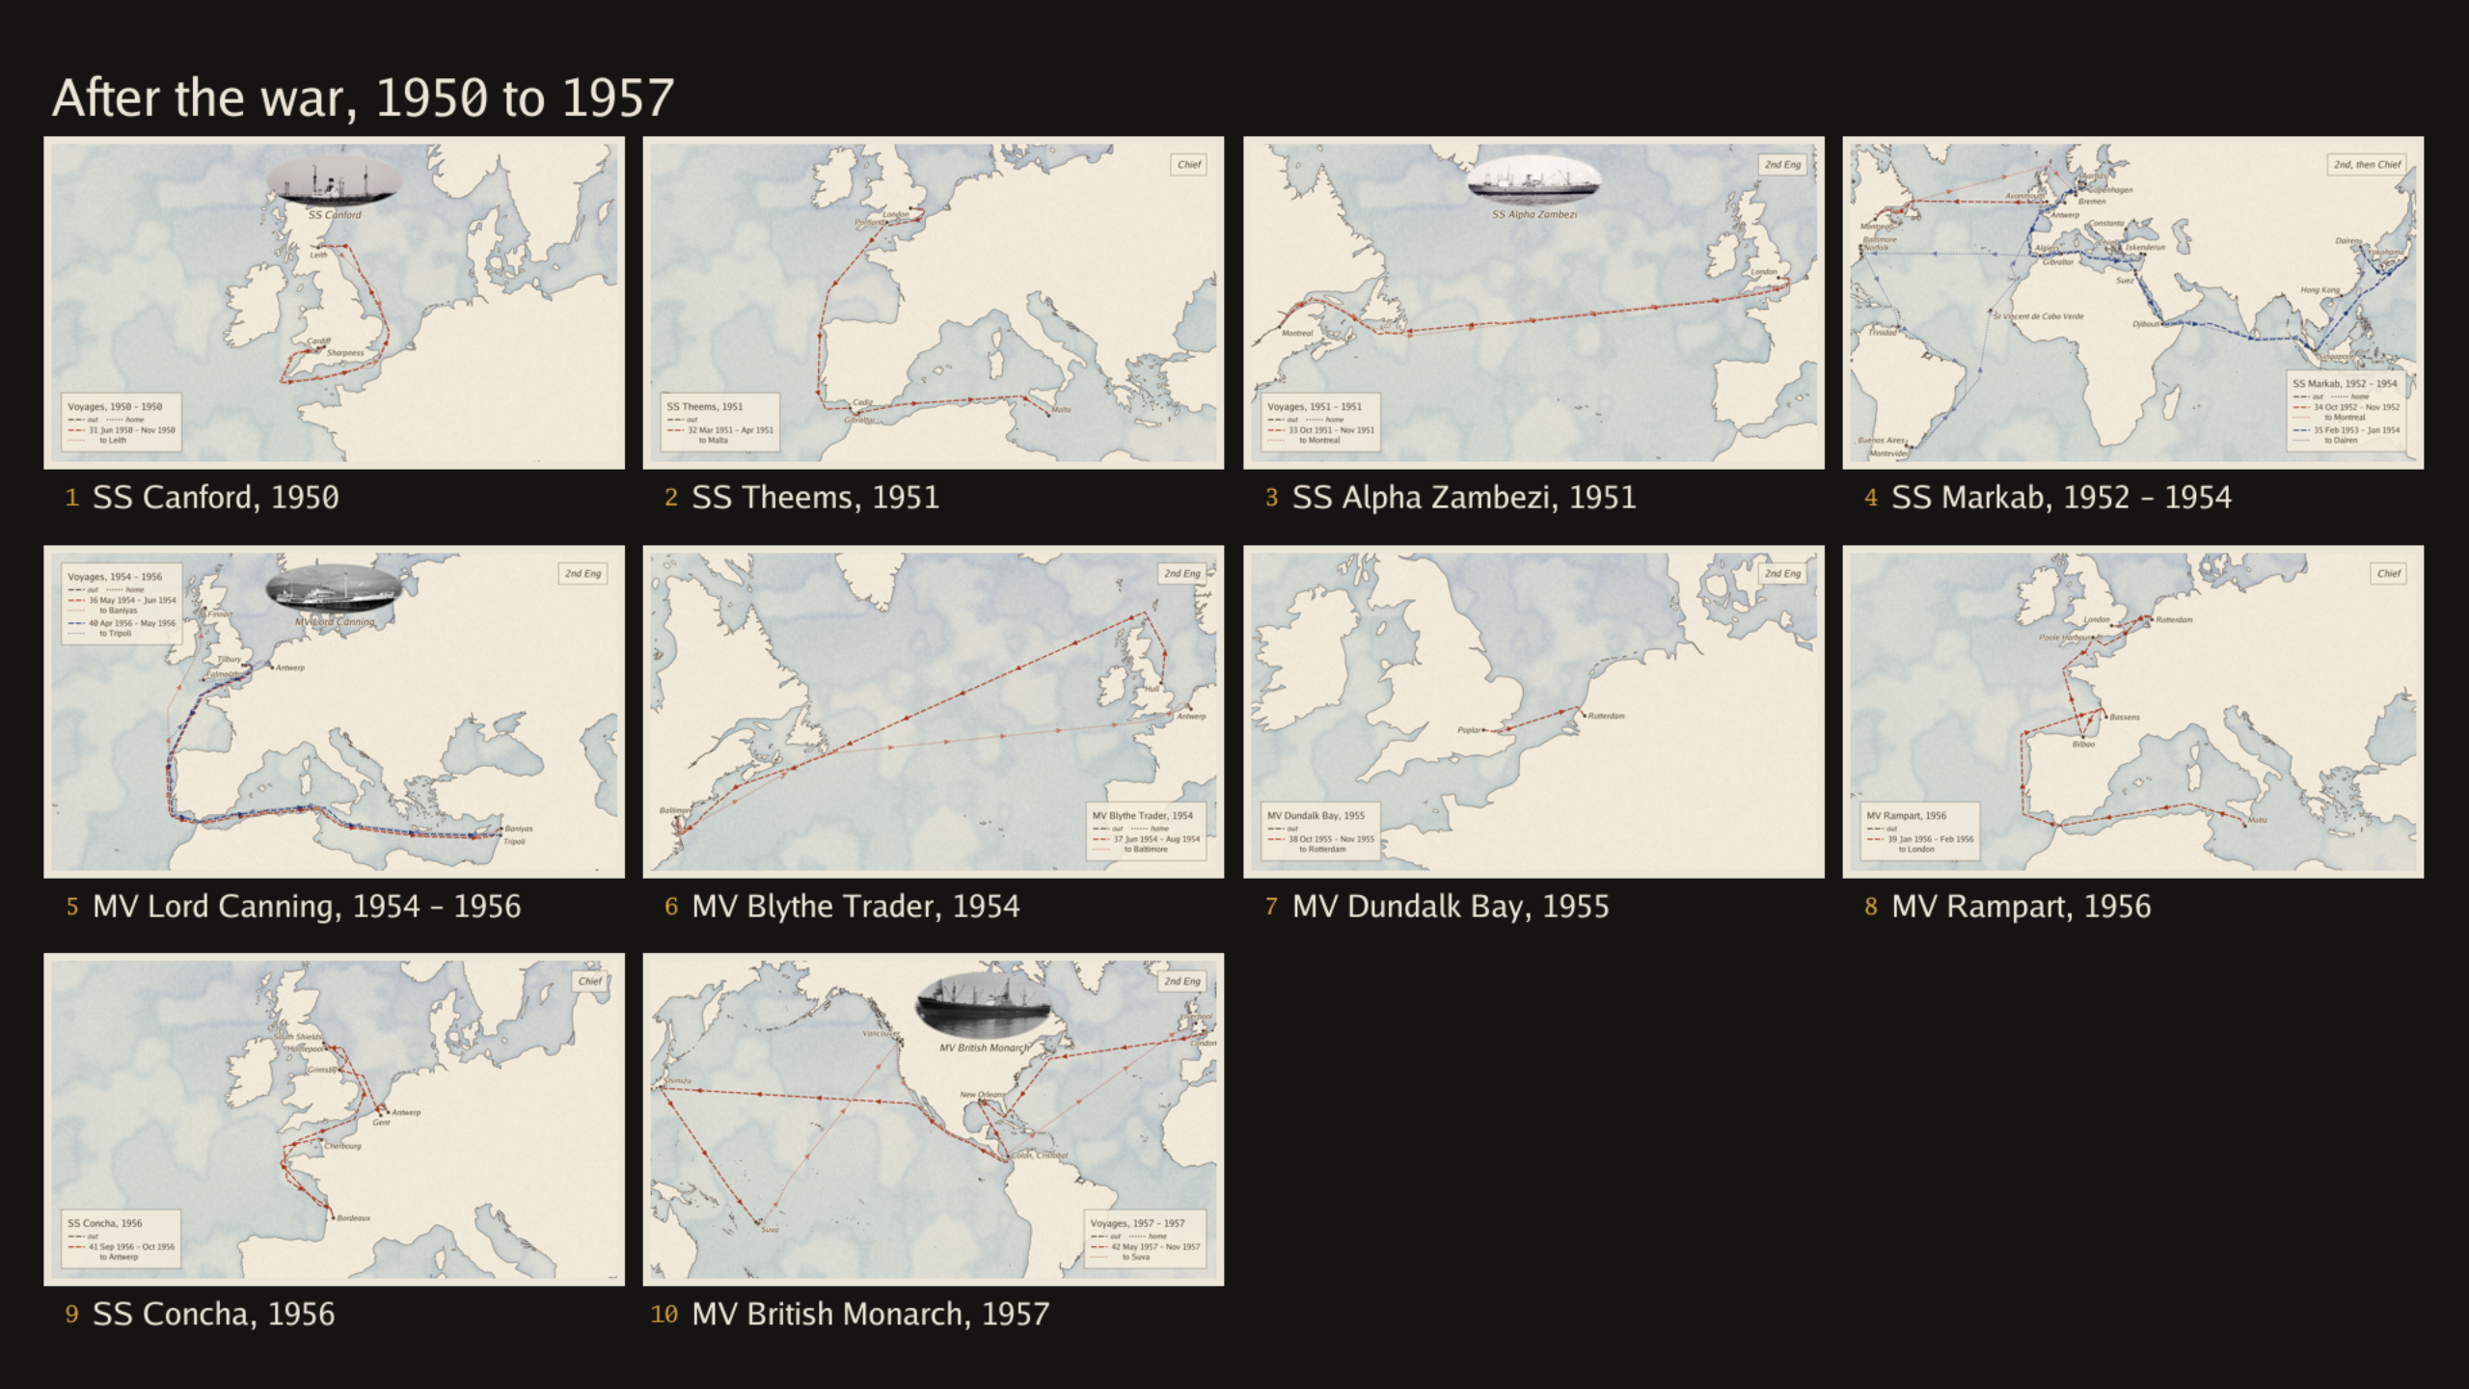

Slide 39
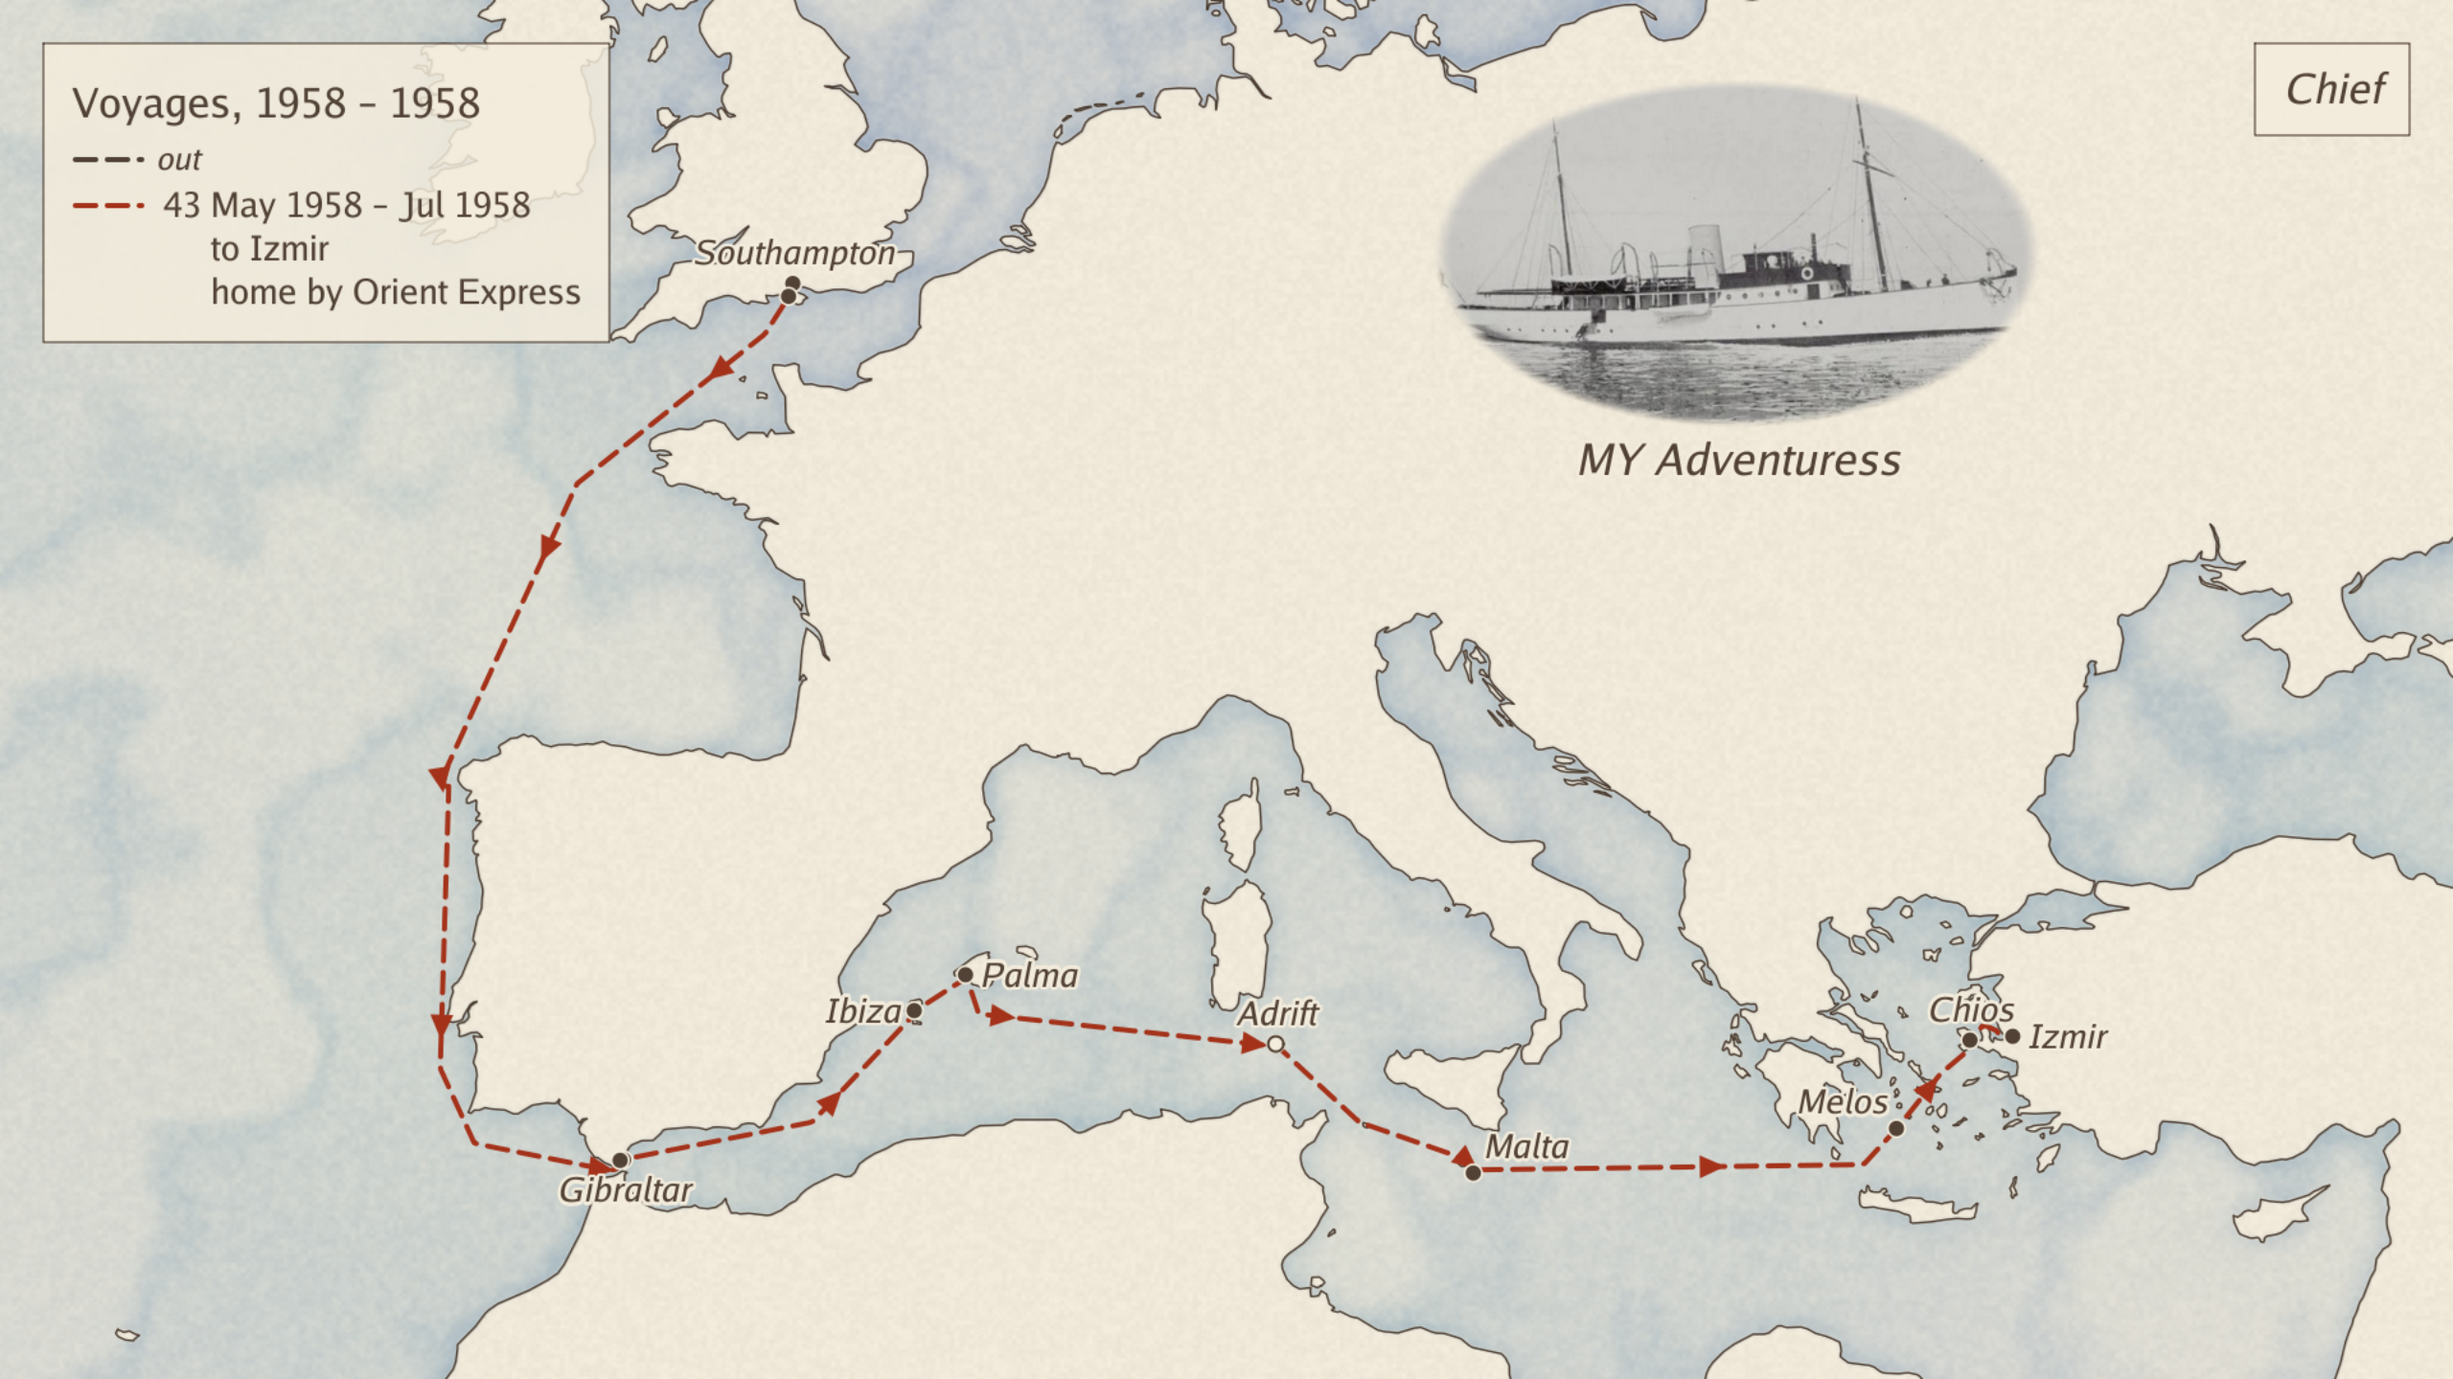
Notes:
She came on board this as chief engineer calling at all sorts of lovely places in the Mediterranean for expenses which she didn't get.
Squadron Leader Williamson

Slide 40
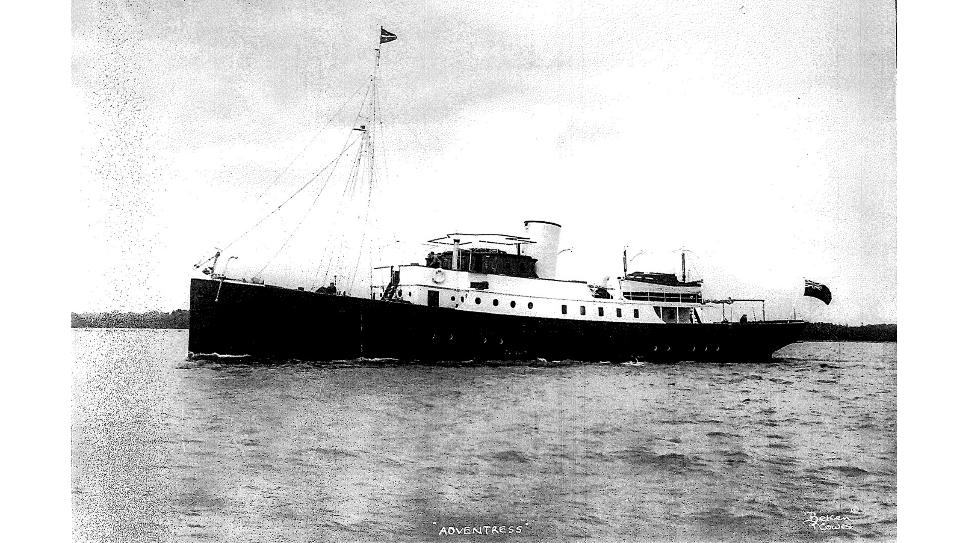
Notes:
Adventuress as at the start

Slide 41
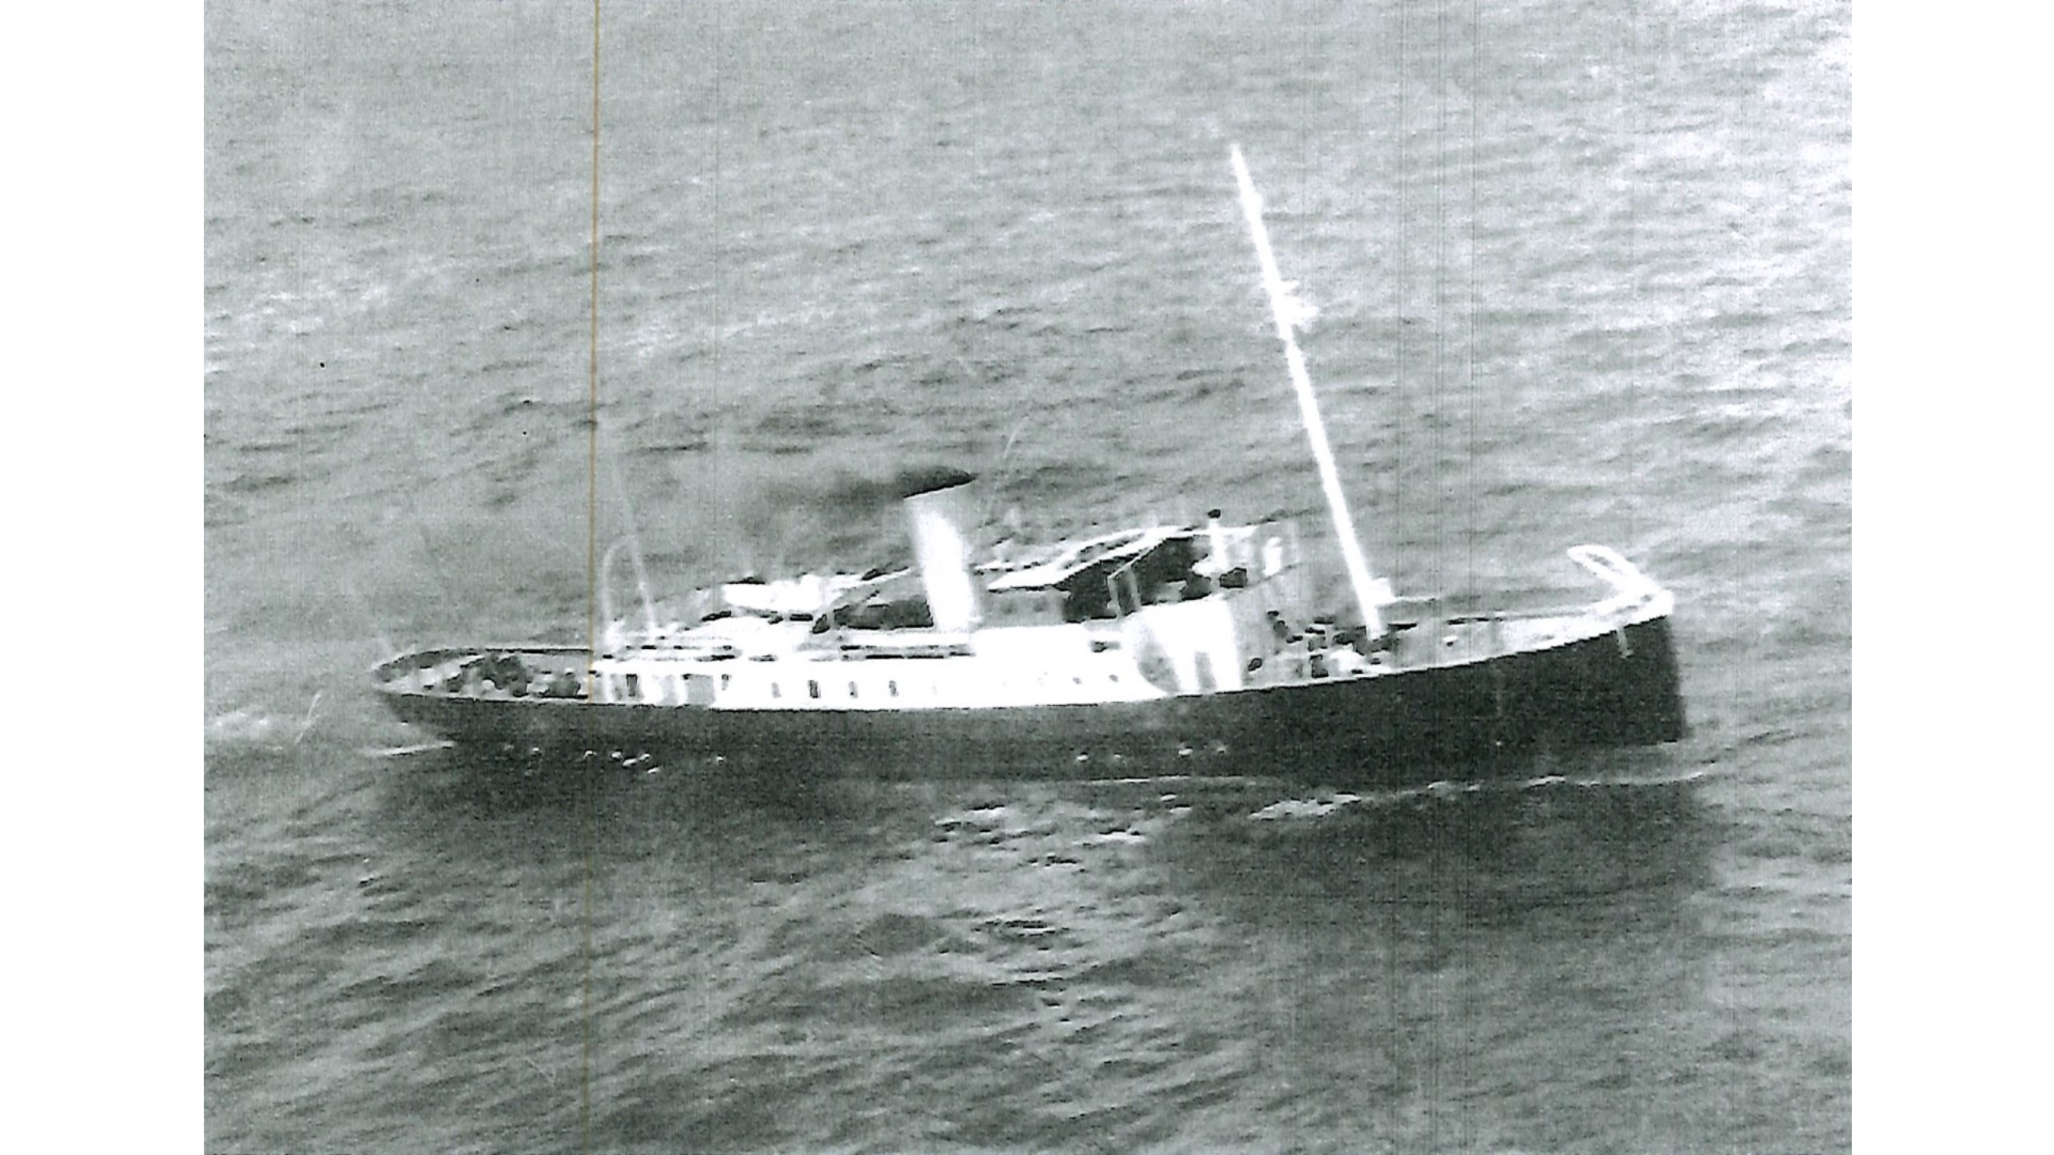
Notes:
Adventuress envoyage

Slide 42
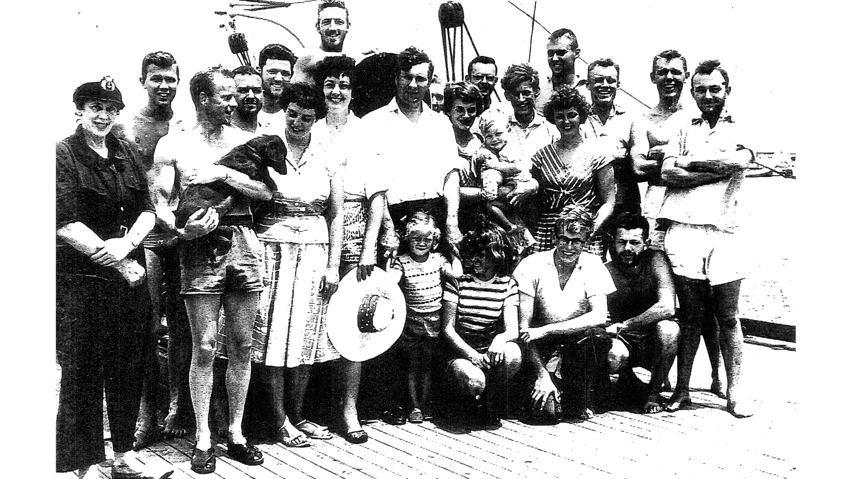
Notes:
Adventuress envoyage

Slide 43
Notes:
She came on board this as chief engineer calling at all sorts of lovely places in the Mediterranean for expenses which she didn't get.
Squadron Leader Williamson
Came home via the Orient express

Slide 44
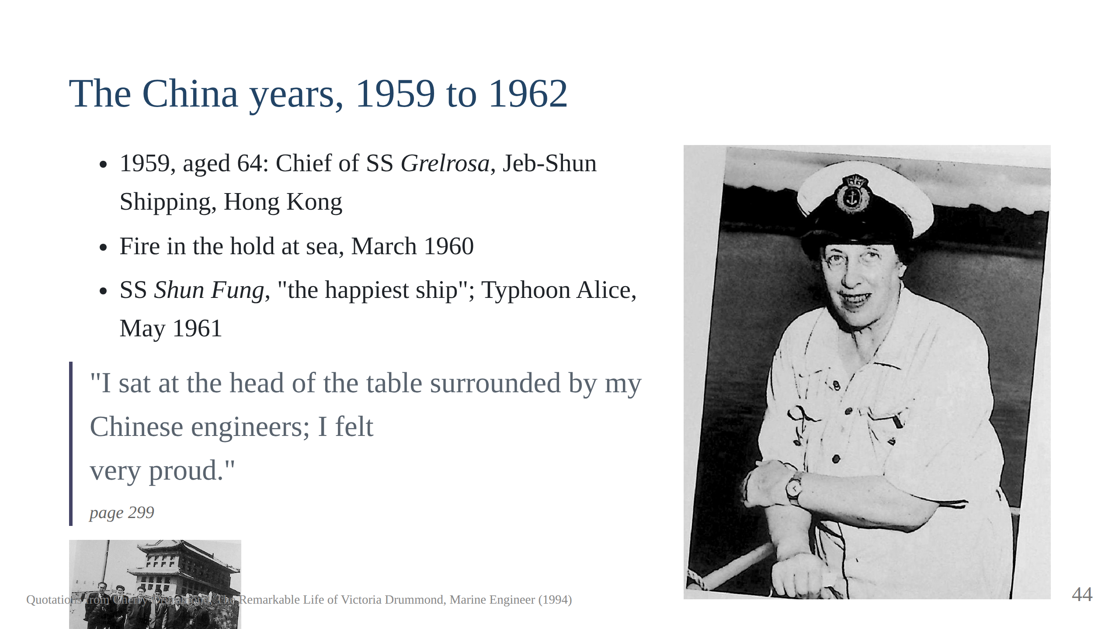
Notes:
The bunch of flowers from the crew. Thawing pipes at Dairen with a
paraffin torch. "So often I had thought, some day I shall go through the
Canal as Chief. And now there were so many times that I had." Script
section 9.
Leaving the Shun Fung, 1 November 1961, "the best ship that I have ever
had": her boy Tsu came to the door of the Marine Office in tears. "Take
me with you, Chief, take me with you! Never another Chief the same, Chief
very, very good." Page 336.

Slide 45
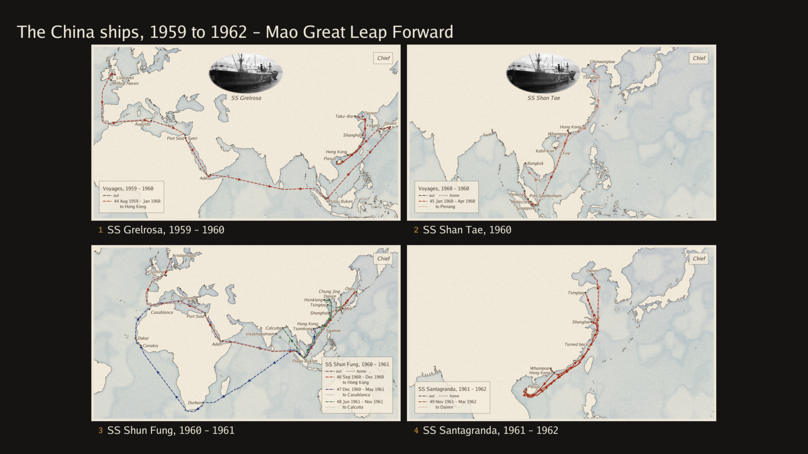

Slide 46
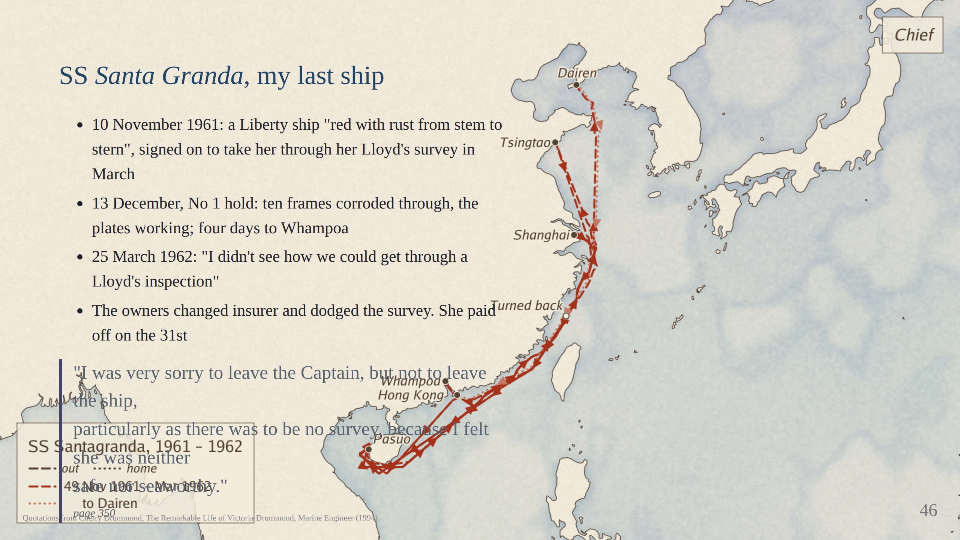
Notes:
Mr Yann came aboard the Shun Fung the day she paid off and asked her to
join the Santa Granda as Chief, £50 a week, six months. At the Black Pier
she saw a 10,000 ton Liberty ship "looking her age and red with rust from
stem to stern without a scrap of paint on her. She looked dirty and
rotten, which she proved to be." Even the porters carrying her luggage
cried "Is that the ship?!" She asked when the survey was due. March. "Will
I be kept on for the survey or paid off?" "Oh yes, yes, you will take her
through the survey." So on she signed. Pages 336 to 337.
13 December, 2 am, pumping continuously in a head sea: the Captain asked
her down No 1 hold. She slid down the mountain of iron ore and saw ten
frames corroded right through at the bottom and broken across, the plating
working backwards and forwards on them, warm to her hand where it flexed
below the weld. With an ore cargo "she would go down very quickly, maybe in
only a few minutes". Make for the nearest port; a double watch in the
hold night and day; shore the frames. Four days to Whampoa. "I was never
more glad in my life to have arrived at any port." Pages 340 to 341.
Sunday 25 March, the last lap to Hong Kong, the Captain laid up with a
broken foot from falling down a hold doing the Mate's job: she told him
she did not see how they could get through a Lloyd's inspection, the ship
was so rotten and carrying ore had strained her badly. In Hong Kong on the
27th the owners came aboard but nobody would say what repairs were to be
done or when the survey would start. Then the Captain came in: they were
not having Lloyd's, they had changed their insurance to a French company,
"so they got out of the survey that way and avoided doing the repairs to
make her safe and seaworthy". Her Second: "I may get money but if I am
dead it is no use to me. I will leave with you. No Chief, no ship." On
the 30th she told the Captain she would pay off next day; by rights she
should have been on pay to May. Pages 349 to 350.
All night packing and finishing her abstracts; fuel, oil and stores
correct to a figure. The Captain asked her to stay a few days. The crew
gave her a silver junk in a glass case, the carpenter made a box for it
packed with engine room waste, and she sailed away in the wallah wallah
with the Captain and his wife waving from the deck. Aged 67. "This had
been my last voyage and the Santa Granda my last ship, but I did not know
that then." Pages 350 to 351. Script section 9.

Slide 47
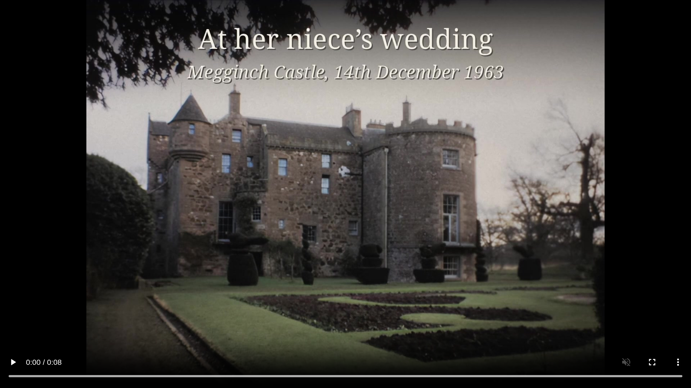

Slide 48
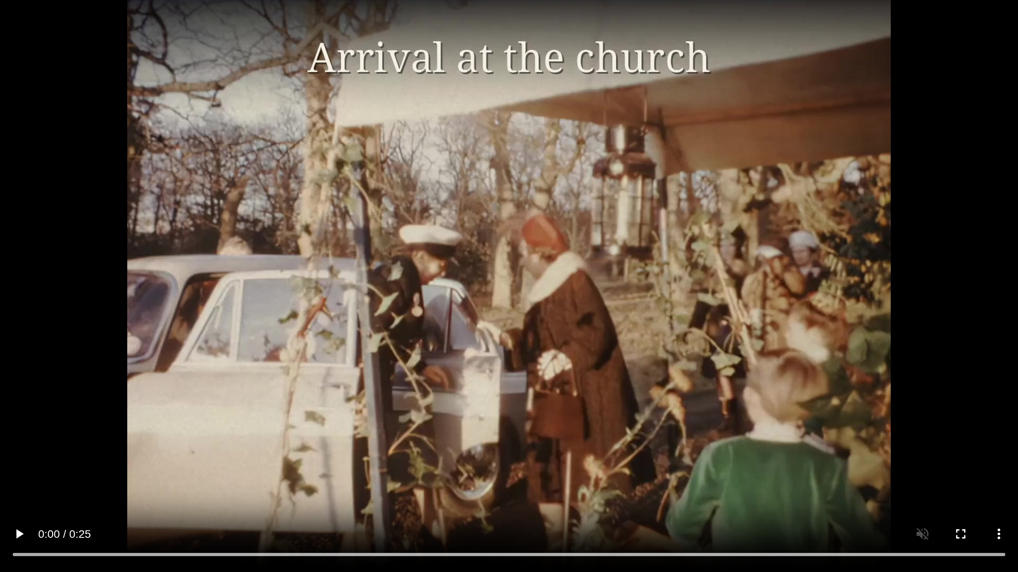

Slide 49
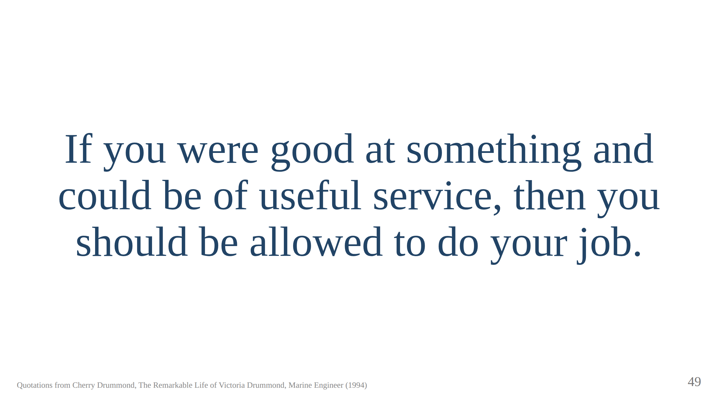
Notes:
The old lady at the annual meetings with an exercise book. The Institute's
Victoria Drummond Room was in the Memorial Building at 76 Mark Lane, left in
1999 and demolished; nothing found naming a room at Coleman Street, Aldgate
House or One Birdcage Walk. Other commemorations: Abertay University blue
plaque, Dundee; Scottish Engineering Hall of Fame and the Drummond Theatre
at HMS Sultan, both 2018; the Nautilus International Victoria Drummond
Award; and the Tube map, which brings the talk back to the apron. Never the
piece of paper; always the job. Finished with Engines. Full Away. Script
section 10.

Slide 50
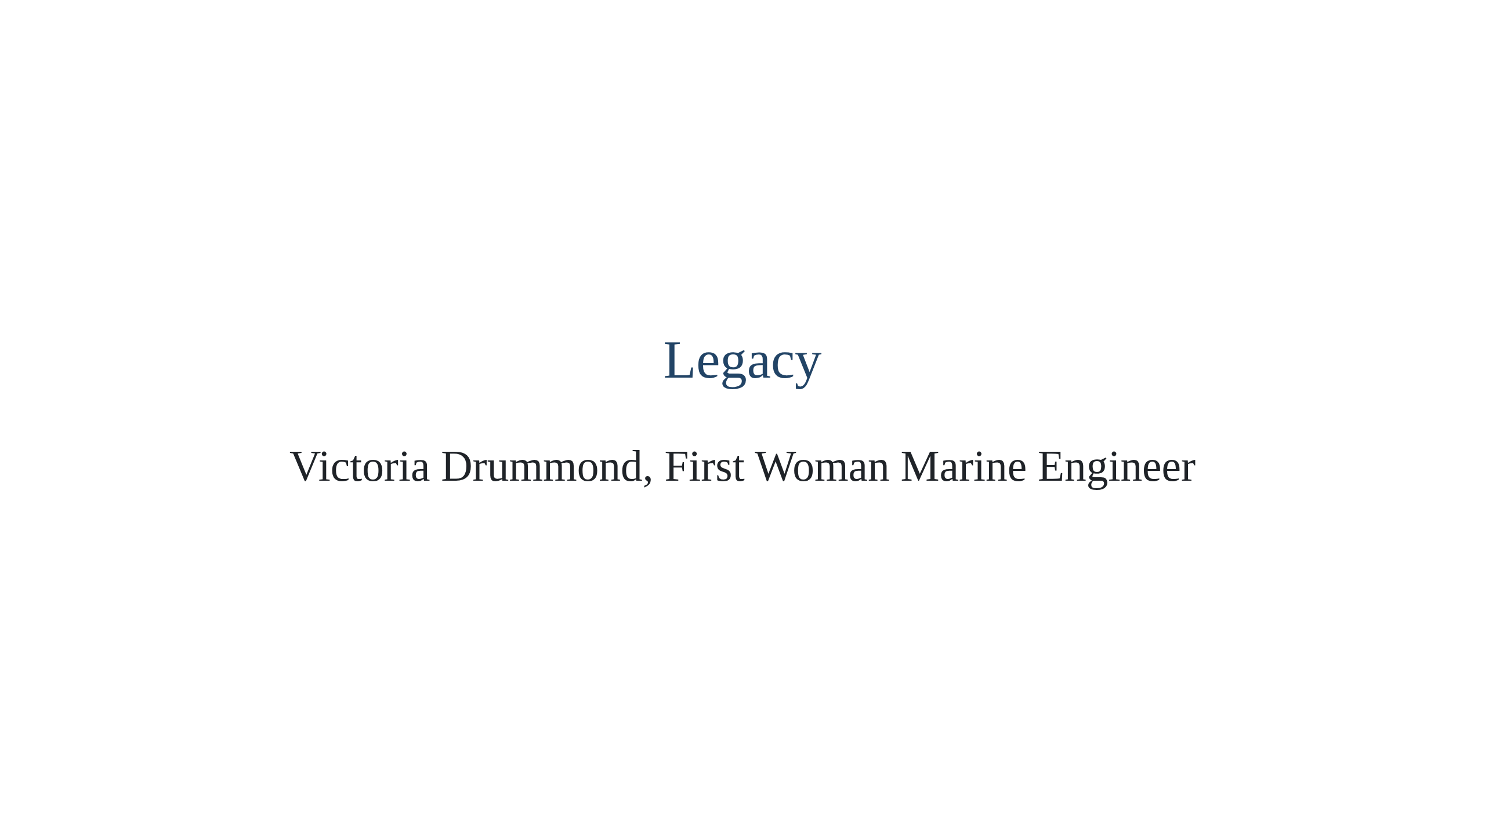

Slide 51
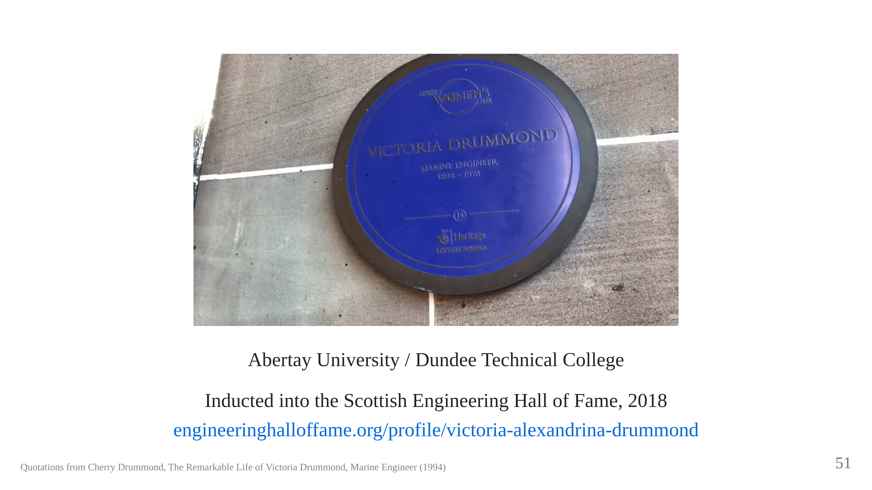

Slide 52
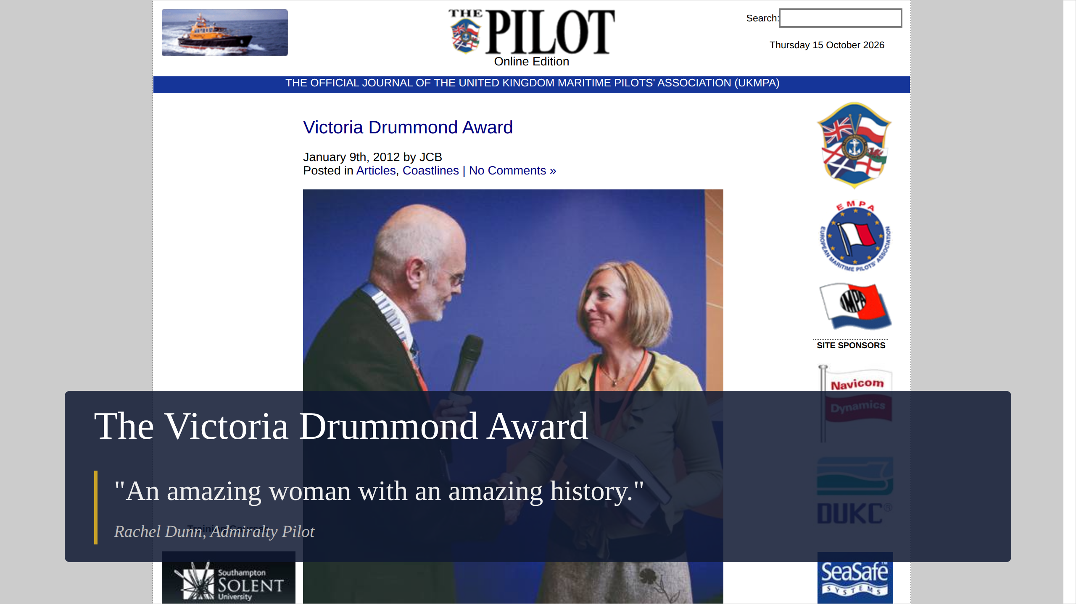
Notes:
The Victoria Drummond Award, set up by Nautilus (seafarers' union), is presented to women whose achievements boost the profile of women at sea.
The Pilot, journal of the UK Maritime Pilots' Association, 9 January 2012:
pilotmag.co.uk/victoria-drummond-award. Nautilus International's Victoria
Drummond Award, presented by Sir Alan Massey at the first Nautilus
International Conference, to Rachel Dunn, the only female Admiralty Pilot.
To sea as a Shell Tankers cadet in 1984; Master's certificate 1993; Master
with Wightlink; left in 2011 to train as an Admiralty Pilot at Portsmouth,
qualifying after twelve months and due to become fully unrestricted, ready
for aircraft carriers. Photo: Rachel Dunn with Nautilus chairman Ulrich
Jurgens (Nautilus).

Slide 53

Notes:
Victoria Drummond had a childhood fascination with marine engineering.
Resilient in the face of prejudice, she achieved many career firsts – the
first woman marine engineer in Britain, the first British woman to serve as
a Merchant Navy Chief Engineer, the first woman to hold a Board of Trade
Certificate as a ship's engineer (having been failed many times because she
was a woman) and the first woman member of the Institute of Marine
Engineers. As a result of her courage under fire at sea during World War
II, she was awarded an MBE in 1941 and was the first woman to receive the
Lloyd's War Medal for Bravery at Sea.

Slide 54

Notes:
Wikipedia, en.wikipedia.org/wiki/Victoria_Drummond. Commemorations: 2013
"Women in Science" exhibition, National Library of Scotland; blue plaque on
the Old College, Abertay University (then Dundee Institute of Technology),
on the Dundee Women's Trail and Dundee Global Trail; 2018 Scottish
Engineering Hall of Fame; 2018 the Drummond Theatre at HMS Sultan, Gosport,
training the Royal Navy's marine and air engineers. Wartime: the Victoria A.
Drummond Canteen in Lambeth, funded partly from Virginia. Wikipedia says
IMarEST has a Victoria Drummond Room at its headquarters, which disagrees
with the book and the notes on the Full Away slide.

Slide 55

Notes:
Her grave at the Chapel, Megginch Castle: a visiting marine engineer at
the end of her pilgrimage, her hand on Victoria's stone. Inset: flowers
left for her 125th birthday, 14 October 2019, by Emily Buck, a 4th Class
Marine Engineer. The card tucked in among them is on the next slide.

Slide 56

Notes:
The card left with the flowers, read aloud (abridge the first part as
time allows):
Dear Chief,
When we find ourselves facing obstacles because of who we are, we can
look to your story and feel less alone in our work.
It is disheartening that we still sometimes struggle to be given a chance
to rise or fall on our own merits, as you also did 100 years ago.
Yet, we are inspired by your practical and honest determination to take
care of your ships, your crewmates, and yourself. You seem to have always
found the joy in a seafarer's life whenever you could.
As every year more women sail the course that [you] first charted, we
treasure your example and take ever greater pride in your
accomplishments.
On your 125th Birthday, we take time to celebrate Victoria Drummond for
her leadership, devotion to duty, determination, and bravery in the face
of bombs, bullets, and bullies.
Presented by Emily Buck, 4th Class Marine Engineer, for all those women
marine engineers.
[The card's own sign-off is hidden by the flowers after "on behalf of
those of us w…"; the line above is how it is read in the talk.]

Slide 57


